Slide 1
myGovID for Employment Service Providers
John Dardo – Senior Responsible Officer NESM
20 October 2021

Slide 2
Agenda
Rollout of myGovID
What’s changing
Timeframes
Setup and support
Update on improving provider experience
Update on Right Fit for Risk
2

Slide 3
MyGovID
2 million business users
already use myGovID to access 76+ Government services
A more flexible, streamlined and secure
way to access online Government services
Enables us to maintain community confidence
Aligns with
whole of Government Digital Transformation Strategy
Staff members of all service providers using ESSweb will need to register as individuals.

Slide 4
Transition Timeline
All Provider staff can get a myGovID today
1 February 2022
28 February 2022
25 March 2022
Phase 1 (commencing)
Provide information
Phase 2a
Switch on myGovID registrations
Phase 2b
Legacy authentication unavailable for new registrations.
Phase 3
Decommission
legacy authentication

Slide 5
How does the current Authentication work?
Microsoft B2C
Provider User
Verifies User Identity
Assigns Role Claims
Identity Provider
Service Provider

Slide 6
How will myGovID work?
Identity Provider
Service Provider
Provider User
Verifies User Identity
Assigns Role Claims
A Standard identity strength myGovID is required for ESS

Slide 7
What is Relationship Authorisation Manager (RAM)?
Allows a provider to determine who can act on behalf of their business online
Authentication service provided by the Australian Government
Three levels of access
Principal Authority
Authorised Administrator
Users

Slide 8
myGovID & RAM: Set up an Administrator
1
1 min
2
1 min
3
1 min
RAM
Log in to RAM using myGovID
Select Manage Authorisations and then select the Provider’s ABN
Add Joe as Authorised Administrator by entering his full legal name and email address
Enter Access Duration and ‘Yes’ to Authorised Administrator.
Review and submit
Toni
Principal Authority
1
Set up myGovID (5 mins)
2
Accept the authorisation (2 mins)
5 mins
RAM
2 mins
Joe
Authorised Administrator
Setup myGovID by entering personal details and prove identity up to ‘Standard’ strength
Go to RAM and accept the Authorisation sent by Toni

Slide 9
myGovID & RAM: Set up an ESS user
Create RAM authorisation (4 mins)
Customise access (5 mins)
1
1 min
2
1 min
3
2 mins
4
5 mins
RAM
Joe
Authorisation Administrator or Organisational Security Contact for the Provider
Add Chris as a new Standard user by entering his full legal name and email address
Setup the Agency Access and click ‘Custom’ access for DESE then review and submit
Go to DESE eSAM access management.
Create an invitation for Chris and assign appropriate access roles
Log in to RAM using myGovID
Select Manage Authorisations and then select the Provider’s ABN
Set up myGovID (5 mins)
Accept authorisations and login (5 mins)
1
5 mins
2
2 mins
3
2 mins
4
1 min
RAM
eSAM
ESS Web
Chris
Provider Employment Consultant
Setup myGovID by entering personal details and prove identity up to ‘Standard’ strength
Go to RAM and accept the Authorisation sent by Toni
Go to eSAM and accept the invitation sent by Toni and link the account to myGovID
Log in to ESS Web with myGovID

Slide 10
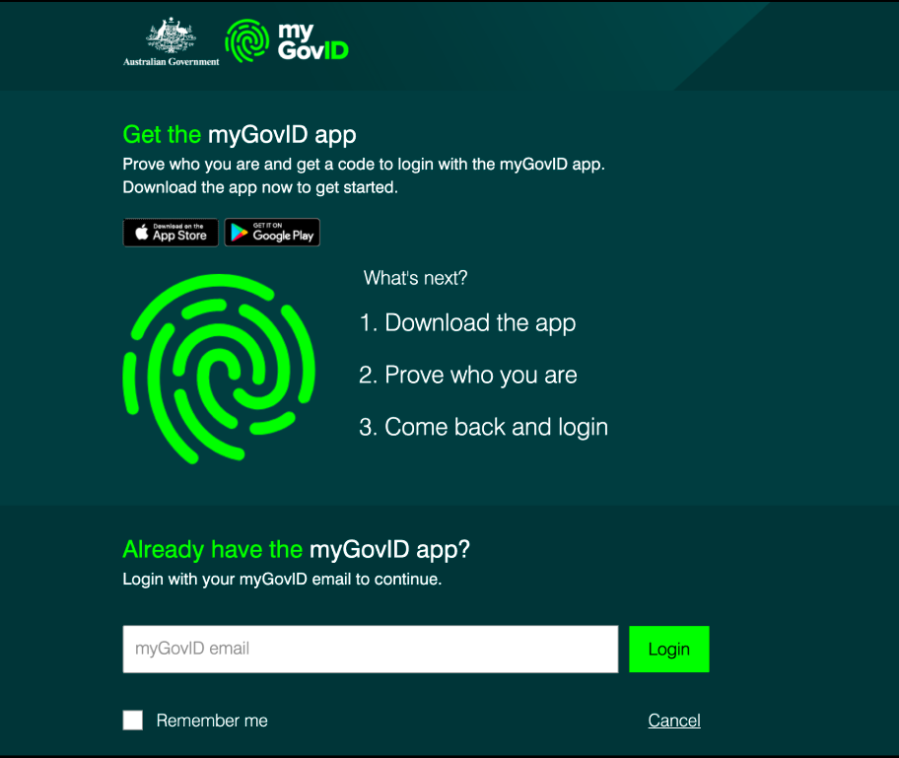
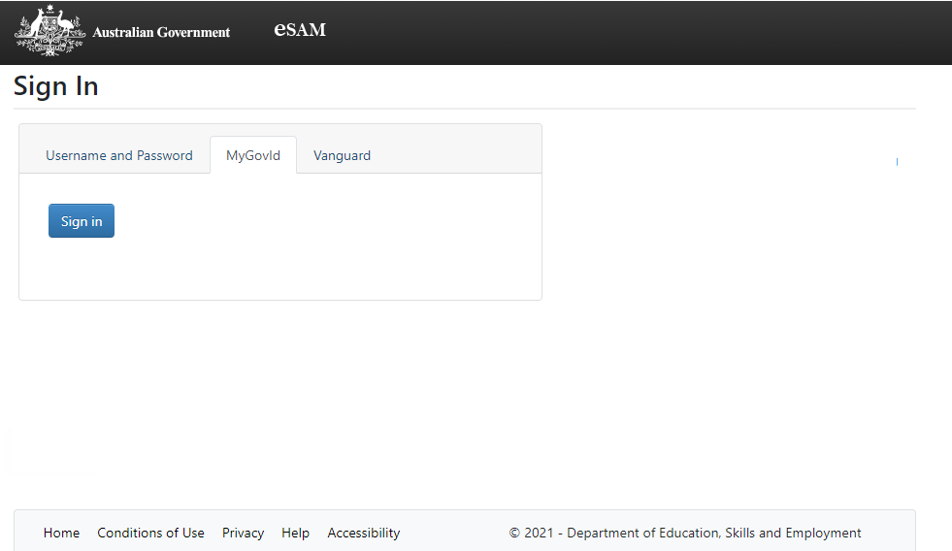
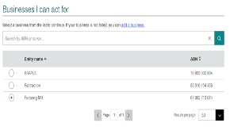
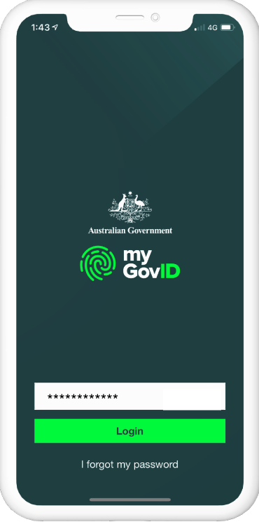
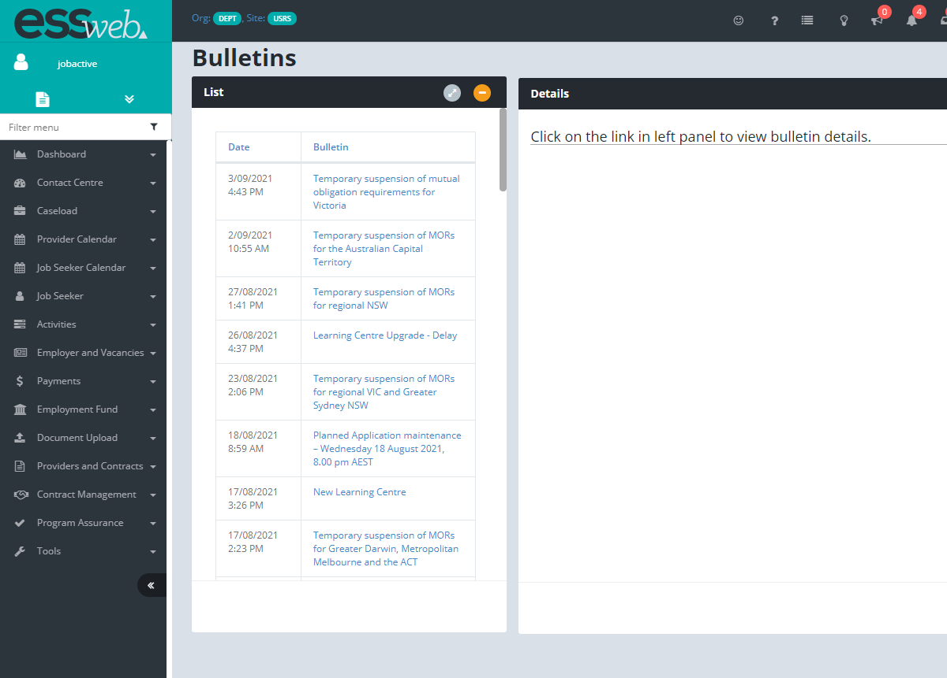
High-level user journey
User logs in to ESS Web
Step 2: User enters their myGovID email address
Step 3: Login request code displayed
Step 1: User logs into ESS Web using myGovID
Step 4: User logs into myGovID app on their smart device and enters login request code
Step 5: If user has access to more than one business in RAM, the ABN selection screen is displayed
Step 6: The user is logged into ESS Web for the selected business

Slide 11
myGovID and Third Party Employment Systems (TPES)
Feedback indicates no significant change is expected
TPES vendors have been informed of the move to myGovID
TPES authentication systems will not be affected
TPES systems that interact with ESS will not be affected

Slide 12
Detailed plan for engagement
Information Forums
Phased communications
Instructional content and training materials
Monitor myGovID adoption
Training for State Office and Helpdesk staff

Slide 13
?
Frequently Asked Questions
Do I need mobile phone coverage to use myGovID?
Only internet access is required (WiFi, Bluetooth or mobile data)
?
?
Will it cost money to use myGovID?
No, there are no user charges for myGovID.
?
?
Do I need an expensive smartphone to setup and use myGovID?
A simple iOS or Android device is required.
Does this mean that staff can only see ESS on the smartphone or mobile device that I used to setup the myGovID app?
login to ESS using myGovID as your authentication and then continue to work in ESS via any browser enabled device including a PC or laptop.

Slide 14
?
Frequently Asked Questions
Who does myGovID belong to?
myGovID belongs to the individual.
?
Do Providers need to build any new IT systems?
No new IT systems required.
?
?
Will staff need a new myGovID if they change employers?
Staff keep the same myGovID account forever
?
If myGovID belongs to the individual user, how does an employer or provider control the access of their staff?
Employers or providers control an individual’s authority to access ESS.
?
Has myGovID been rolled out elsewhere and have we learnt anything from other implementations of myGovID?
Approximately 2 million users currently use myGovID to access Government online services

Slide 15
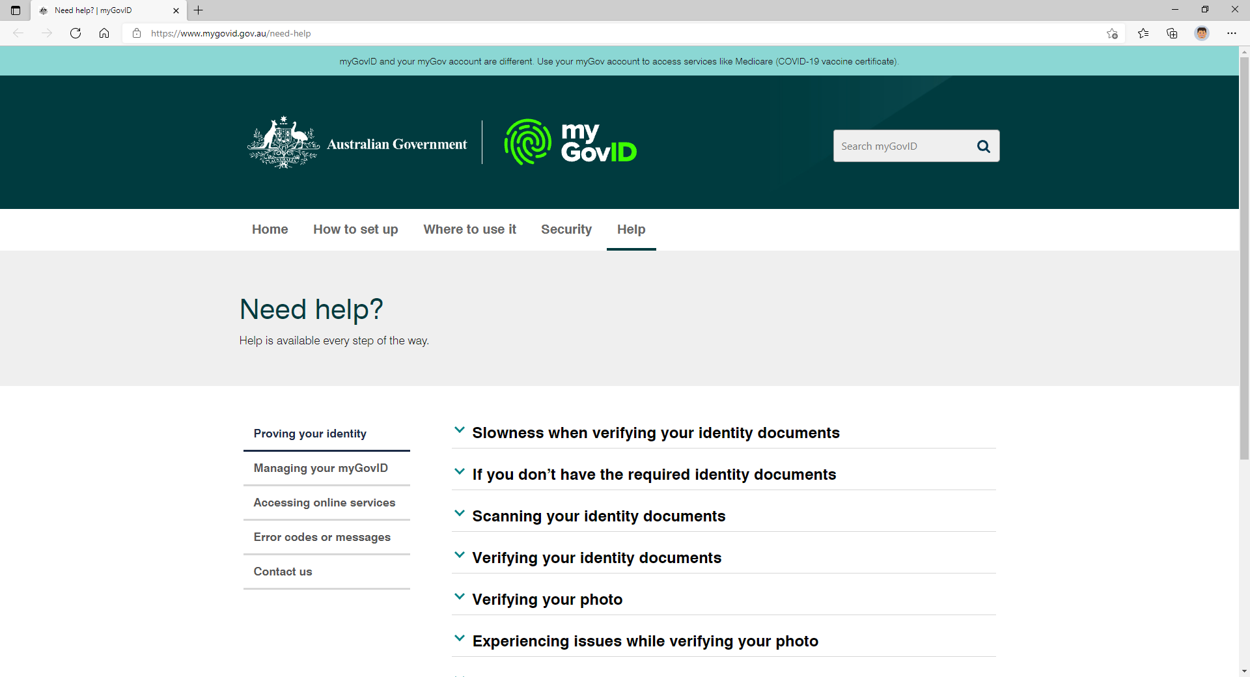
Insert DESE URL when available
Where can I find out more?
https://www.mygovid.gov.au/need-help

Slide 16
UPDATE Improving Provider Experience

Slide 17
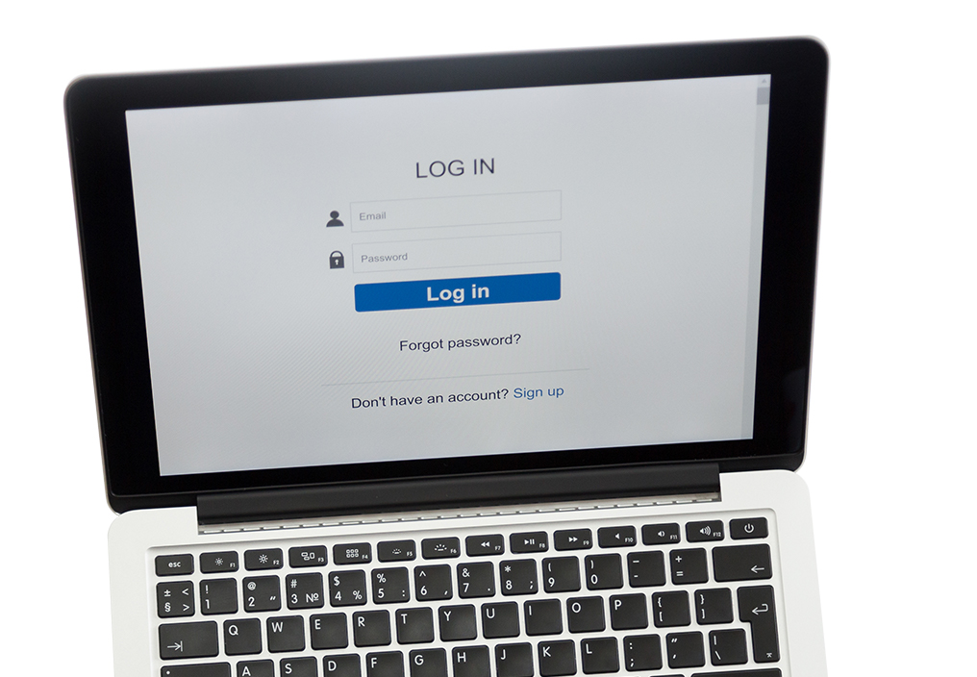
Usability Testing
The Department is engaging with over 70 organisations and over 400 people who opted in to be part of usability testing.
Functionality will be released incrementally in a Beta state.
​Allowing quick insight into the platform and the functionality before July 2022.

Slide 18
Research Goals and Clear Findings
!
Issues identified
Tested well
Workflows in ESS Web do not have a firm structure and are performed by memory.
No single place to view job seeker information in an easily digestible format.
Prefilling fields and providing rapid-complete functionality.
Structuring an update and providing a sense of progress using sections.
Ability to see an entire calendar at a glance.

Slide 19
UPDATE Right Fit for Risk Requirements

Slide 20
Update on RFFR
As at 15 October, 32 Medium and Large Providers have completed the RFFR Accreditation process, and 24 are currently being assessed.
Note:
Data includes providers delivering DESE employment services .
Data excludes providers delivering DSS only services.
Data excludes providers delivering Skills Program only services.

Slide 21
What happens when Providers do not gain accreditation?
For Medium and Large Providers (servicing 2,000 or more participants)
Medium/Large Providers who met the due date of 30 September 2021 to submit their RFFR documentation are being prioritised for review.
Providers who did not submit RFFR documentation for review by the due date and did not advise the department of a valid reason for being overdue may be in breach of the Deed.
!

Slide 22
Who do we go to if we’re having problems gaining accreditation?
For Small Providers (servicing less than 2,000 participants)
Small Providers are required to gain RFFR accreditation by 31 December 2021.
31
Email SecurityComplianceSupport@dese.gov.au if you are experiencing significant challenges preparing your RFFR submission.

Slide 23
Are the same standards being sought for the new Tenders?
!
i
Capacity to meet Accreditation requirements is one of the factors considered in assessment for TTW and NESM.
Current Providers must gain RFFR Accreditation under current contracts.
Each future approach to market will have its own assessment criteria. Please refer to the relevant approach to market documents for information about the requirements.

Slide 24
RFFR Improvement Initiatives
We want to improve the ways we deliver support and assistance for all Providers to complete the RFFR accreditation process, through improved collaboration and support.
1
2
3
Alternative Assurance
Improve Guidance Material
Higher levels of Support
Enhance Tooling (Mu2)
Expand applicability to more orgs
Self-service portals
Focus on laymen accessible terminology
Update guidance materials
Improve presentation
Openly accessible
Structured to highlight crucial parts
Link to more background information
Personalised support
Engagement methods (meetings, video-conferences)
Start-up packs with reference materials and case studies

