Slide 1
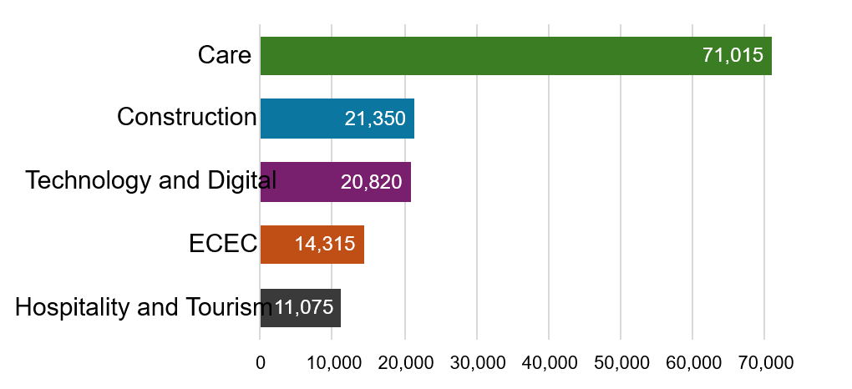
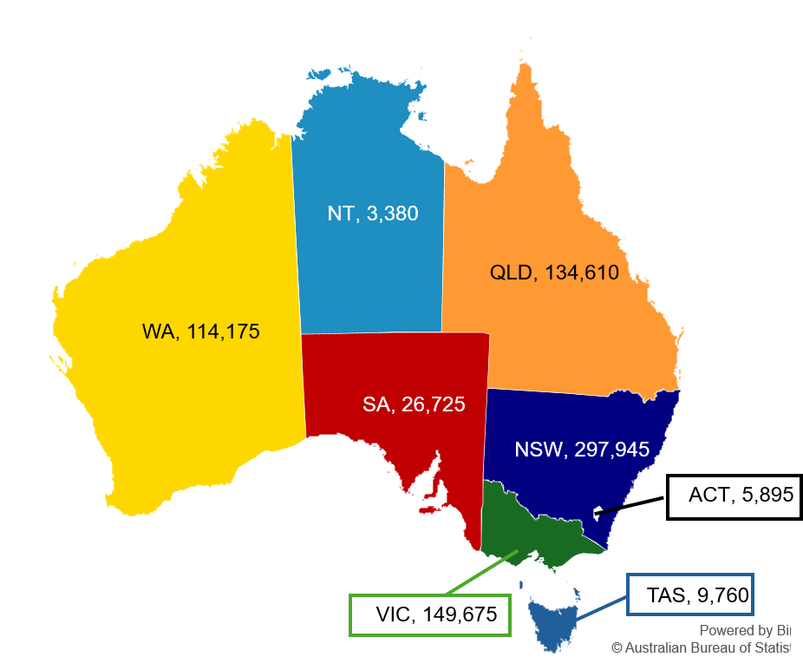
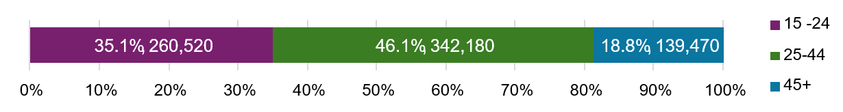
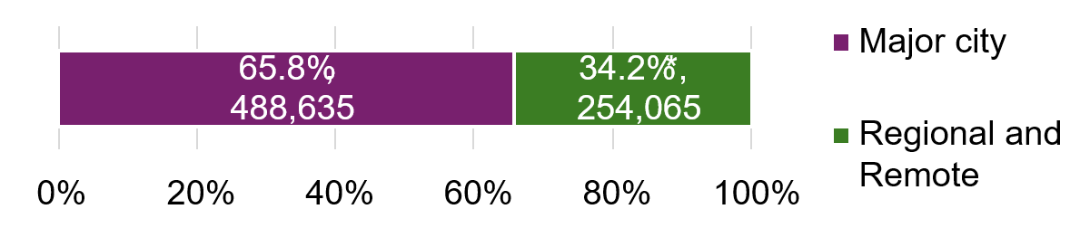
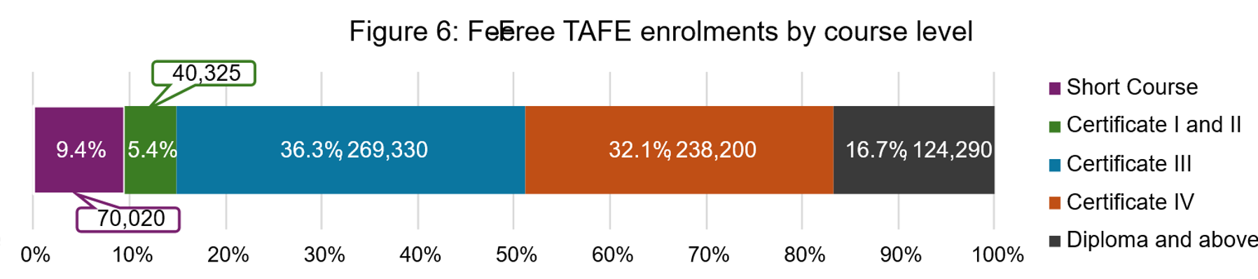
Fee-Free TAFE program (1 January 2023 to 31 December 2025)
Through the Fee-Free TAFE Skills Agreement, the Australian Government has partnered with states and territories to deliver over $1.5 billion in funding for more than 500,000 Fee-Free TAFE and vocational education and training (VET) places across Australia from 2023 to 2026. This snapshot sets out quarterly reporting data over the period 1 January 2023 to 31 December 2025.
Fee-Free TAFE continues to have strong enrolments in all states and territories.
There have been more than 742,000 enrolments from
1 January 2023 to 31 December 2025.
Fee-Free TAFE supports training places in priority sectors and helps priority cohorts access training
Figure 3: National priority sectors with the most Fee-Free TAFE enrolments
As of 31 December 2025, there have been 245,785 completions since Fee-Free TAFE launched in 2023
Figure 8: National priority sectors with the most Fee-Free TAFE completions
Sector | NSW | VIC* | QLD | WA | SA | TAS | NT | ACT | Total
Care | 77,045 | 41,135 | 30,230 | 42,765 | 7,075 | 3,525 | 555 | 1,185 | 203,510
Technology and Digital | 25,065 | 11,580 | 14,190 | 13,355 | 4,760 | 555 | 125 | 1,100 | 70,735
Construction | 17,965 | 19,480 | 10,385 | 4,990 | 4,025 | 940 | 290 | 635 | 58,705
Early Childhood Education and Care (ECEC) | 20,760 | 7,235 | 8,630 | 18,725 | 1,460 | 580 | 305 | 495 | 58,190
Hospitality and Tourism | 12,300 | 3,845 | 2,390 | 5,990 | 1,640 | 885 | 350 | 415 | 27,815
Figure 1: Fee-Free TAFE enrolments by jurisdiction
* Remapping of Certificate IV in Training and Assessment in Victoria has resulted in changes to enrolment numbers by priority sector compared to earlier reporting.
Figure 4: Fee-Free TAFE enrolments by priority cohorts
The top completed courses in Fee-Free TAFE are:
 | NSW | VIC | QLD | WA | SA | TAS | NT | ACT | Total
First Nations Australians | 25,210 | 1,855 | 9,290 | 5,675 | 550 | 830 | 1,525 | 285 | 45,220
People with disability | 17,120 | 16,180 | 13,945 | 11,305 | 1,115 | 1,755 | 320 | 1,500 | 63,235
Job seekers | 110,505 | 31,910 | 24,965 | 5,175 | 6,310 | 2,780 | 600 | 1,785 | 184,030
Young persons (24 and under) | 87,630 | 62,465 | 58,800 | 38,555 | 7,260 | 2,920 | 805 | 2,080 | 260,520
Women | 195,070 | 83,190 | 76,985 | 77,095 | 14,925 | 5,595 | 2,050 | 3,280 | 458,190
Top completed courses
Certificate III in Individual Support
Certificate IV in Training and Assessment
Certificate III in Early Childhood Education and Care
Diploma of Nursing
Certificate IV in School Based Education Support
Fee-Free TAFE helps people in all stages of their working life
Figure 5: Fee-Free TAFE enrolments by age group
And the top completed courses in national priority sectors include:
Figure 2: Fee-Free TAFE enrolments by remoteness ^
Care | Hospitality and Tourism
Certificate III in Individual Support | Certificate III in Commercial Cookery
Diploma of Nursing | Certificate III in Hospitality
Diploma of Community Services | Certificate II in Cookery
Fee-Free TAFE concentrates on qualified training and meaningful pathways to employment
Construction | Technology and Digital
Certificate II in Electrotechnology (Career Start) | Certificate III in Information Technology
Certificate II in Electrotechnology (Pre-Vocational) | Certificate IV in Cyber Security
Certificate IV in Building and Construction | Certificate III in Electrotechnology Electrician
^: The sum does not match the total in Figure 1 due to multiple delivery locations.
*: Includes 0.1% unknown.
Source: State and territory Fee-Free TAFE data reported under Part 3 of the Fee-Free TAFE Skills Agreement.
Notes:
Comparisons should not be made between states and territories’ data due to their varied implementation approaches.
Figures have been rounded to the nearest 5.
The listed total may not match the sum of all elements due to rounding.
Enrolments were aggregated across years based on data submitted at the end of each calendar year and the latest available quarter.
The top enrolled courses are focussed on key areas of national priority
Early Childhood Education and Care
Certificate III in Early Childhood Education and Care
Diploma of Early Childhood Education and Care
Introduction to Early Childhood Education and Care Skill Set
Figure 7: Courses with the most Fee-Free TAFE enrolments
Top enrolled courses
Certificate III in Individual Support
Certificate III in Early Childhood Education and Care
Diploma of Nursing
Certificate IV in Training and Assessment
Certificate III in Information Technology
Note: Completions data is as reported in Quarter 4, 2025. Numbers are expected to rise as more students finish their courses, especially those studying part-time or in longer courses.

