Slide 1
Workforce Australia Overview
Peaks| 14 June 2022

Slide 2
Workforce Australia in practice
New model trialled in two regions
Policy and program changes
Introduction of an online services platform

Slide 3
Business
Individuals
Providers
Government
Assists businesses to source skilled individuals
Supports eligible individuals to find a sustainable job
Focuses high performing providers on supporting individuals who need more assistance
Creates a more efficient model for government
Principles to guide Workforce Australia
Better matching of individuals who meet business’ skill and job needs.
Reduced administration to simplify and accelerate the recruitment process.
Increase business engagement with the services
More personalised and extensive support, including skilling and job pathways.
A new flexible activation framework for individuals to better target mutual obligations.
A new licensing system that allows for specialisation and rewards high performing providers.
Reduced caseload due to job ready individuals using Online Services.
A more focused system with resources and incentives targeted to improving outcomes for higher need individuals.
Agile service delivery model that can be more responsive to changing labour market conditions and policy needs.
We are guided by the principles of simple, supported, connected and respectful

Slide 4
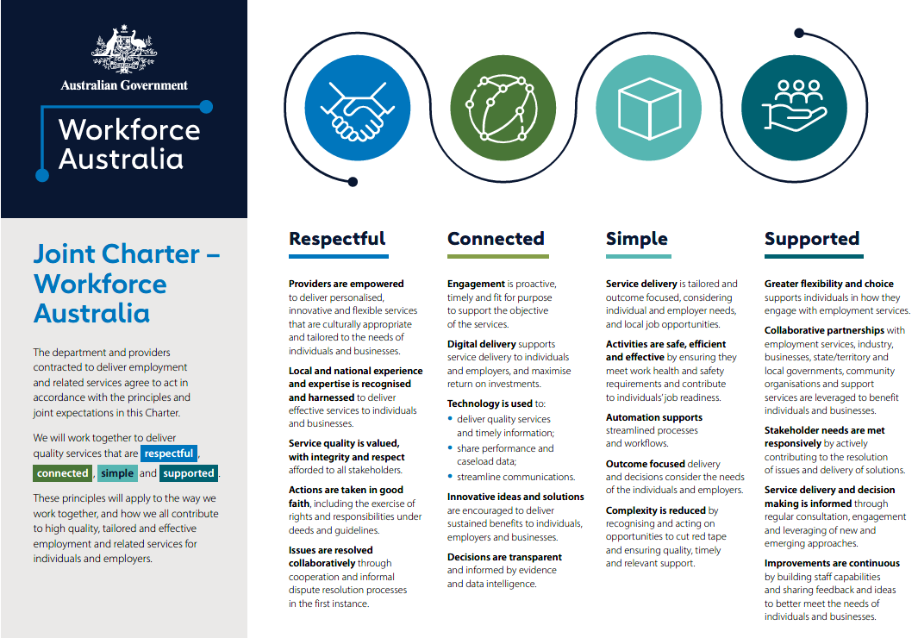

Slide 5
Workforce Australia for Individuals
Stan needs a job
Workforce Australia Online for Individuals
Workforce Australia Services
Stan is job ready and digitally literate
Stan needs more tailored support
He can access online and additional supports as he searches for work
He receives intensive and tailored case management support from a provider
He can move to services led by a provider if needed and is eligible to receive these services
His provider works with him to strengthen skills, experience and provide the support he needs

Slide 6
Job Seeker Assessment Framework - Overview
Ongoing and dynamic assessment process
Better understanding
Supports individuals disclosure and engagement
Targeted recommendations
Guides individuals so they receive the services most relevant for them
Provider own assessment tools
Uses analytics to help inform reviews and target personalised nudges and interventions
Ongoing system enhancements
Better job matching
*The Job Seeker Assessment Framework complements Provider administered assessments and tools. It will use enhanced system capability to grow over time to deliver an enhanced user experience.

Slide 7
The initial assessment process – Job Seeker Snapshot
Individual lodges
income support claim
INITIAL ASSESSMENT QUESTIONNAIRE: THE JOB SEEKER SNAPSHOT
Strengths-based questions on individuals’ skills, qualifications, education and career interests
Future technology and system enhancements will allow the pre-population of the Job Seeker Profile
Participation Interview
Questions that determine risk of long-term unemployment
Job search confidence question
Questions that help identify an individuals’ internet access and ability
Questions that help identify the need for an ESAt

Slide 8
Safeguards to support participants in Workforce Australia Online
Eligible participants can choose to be supported by a provider at any time
Initial assessment identifies most job ready and those with complex barriers. Also asks about digital access and ability to use online tools
Participation Interview
Digital Service Review at 4 and 8 months
Time limited service
The Digital Services Contact Centre available to support job seekers
Need a linked myGov account

Slide 9
Flexible activation through a points based system
20 job searches no longer required
Adjustable based on Stan’s circumstances
20
10/40
Points gained from a range of employment related tasks and activities
When met, Stan can bank points for next reporting period
Stan agrees to his job plan
New points target to meet each reporting period

Slide 10
Mandatory activity requirements for individuals
Workforce Australia Online participants
Participants exiting online services at 12 months
Individuals in Workforce Australia Services
Have a mandatory requirement at 4 months if:
Have a mandatory activity requirement within 3 months in Workforce Australia Services if:
Have a mandatory requirement at 6 months if:
not in work or study – program focusing on ‘soft skills’
not engaged in activities and progressing towards employment
not engaged in work, study, training or work experience
working or studying but not meeting their mutual obligations – default is an Online Learning Module
Work for the Dole is the default mandatory activity.
Work for the Dole is the default mandatory activity.

Slide 11
Targeted Compliance Framework - unchanged at policy and design level

Slide 12
Employment Fund, wage subsidies and relocation assistance
Payment type | Available in Online Services? | Available in Workforce Australia Services? | Features
Employment Fund | Yes Core items | Yes Full range of support available | Streamlined and automated Targeted to those who need it the most
Wage subsidies | No | Yes For most, 6 months after commencement in provider-led services | Targeted to those who need the most support Simplified, reduces red tape
Relocation assistance | Yes | Yes | Streamlined, reduces red tape, more flexible

Slide 13
Workforce Australia for Providers
Sue’s organisation is issued a Specialist or Generalist licence
Generalist Licence
Specialist Licence
Eligible Individuals
Refugees
Sue works for a Workforce Australia Employment Services Provider
Culturally and Linguistically Diverse (CALD)
Indigenous Australians
Ex-offenders
*May be expanded in the future

Slide 14
Workforce Australia for Providers
Stan enters Workforce Australia Services
Stan finds a job
10/40
Sue develops a tailored, personalised plan for Stan
Sue can adjust Stan’s support when his circumstances change
Sue’s connections creates opportunities for Stan
Sue works for a Workforce Australia Employment Services Provider

Slide 15
New provider payment model
Upfront payments
Payable upon commencement with a Workforce Australia Employment Services Provider
$1200 for new eligible individuals
$600 for transition or transferred individuals
1
2
Progress payments
Payable for progression towards employment
$750 payment available once every 24 months
Employment outcome payments
Payable for remaining in employment for 4/12/26 weeks
Full or partial outcomes
From $240 to $5000
3
4
Very long-term unemployment bonus
Paid on top of 12 and 26 week employment outcomes for individuals who have been unemployed for over 24 months
From $1,000 to $4,000

Slide 16
Workforce Australia for Business
Anna owns an aged care business called Total Care and needs staff
Workforce Australia Online for Business
Workforce Australia Employment Services Providers
Complementary Services
Anna can use the platform to find suitable candidates for employment
Anna works with a provider with experience in short-listing and pre-screening
Anna can have access to a range of programs, services and resources to support workforce planning
A large pool of job-ready individuals are available
The provider tailors pathways for Anna
Anna may receive tailored recruitment services for industries and businesses if she has a large number of vacancies
Supports are available to help Anna transition new employees

Slide 17
Workforce Australia – Workforce Specialists
$12.5 million each financial year
Industries and occupations with high demand for labour and strong growth prospects, particularly for entry-level roles
The Workforce Connections: Workforce Specialist Project Framework will guide and inform Workforce Specialist Projects
Individuals registered in Workforce Australia Services, Workforce Australia Online and Workforce Australia – Transition to Work.

Slide 18
Workforce Australia - Transition to Work
What’s staying the same?
What’s changing?
Non-competitive service delivery and collaboration between Providers.
Flexible service delivery.
Demand-driven funding and a funding model that encourages upfront investment in young people.
Access for disadvantaged young people not in receipt of income support.
Consequence for non-compliance with Mutual Obligation requirements.
Access to Youth Bonus Wage Subsidy.
Youth Advisory Sessions.
Expansion of eligibility criteria to capture more at risk young people.
Extension of maximum time in service for those young people with significant Non-Vocational Barriers.
A new Income Support Suspension lever to improve attendance at initial appointment.
A new Performance and Quality Framework to better foster continuous improvement.

Slide 19
Workforce Australia - Employability Skills Training (EST)
Eligibility
Course Content
Payment Settings
Placement Management Services (PMaS)
Eligible job seekers aged 15+ in Workforce Australia Services, Workforce Australia Online Services, Transition to Work or Disability Employment Services.
Participants in Transition to Work and Disability Employment Services can participate for the first time, on a fee for service basis.
Participants in Workforce Australia Services also participate on fee for service basis.
Default activity for Online Participants at mandatory stage of Four Month Activity Requirement.
Training Block 1
Pre-employment soft skills
Advanced job search skills
Training Block 2
Industry specific training
Focus on local labour market industry needs
Can offer accredited training
Direct link to work trials that have a reasonable prospect of employment
Prepare participants for entry-level employment opportunities in specific industries.
Note that course content must be tailored to meet the needs of individual EST Participants, as informed by the initial assessment
Course Fees
Workforce Australia Online / Yarrabah
Training Block 1 & 2
$1250, funded by department
$875, commencement (70%)
$375, final* (30%)
Workforce Australia Services & Transition to Work
Training Block 1
funded by referring provider
$1250, full fee for service
Training Block 2
$300, funded by referring provider
$950, funded by department
$575 commencement
$375 final*
Disability Employment Services
Training Block 1 & 2
funded by DES provider
$1250, full fee for service.
*EST providers are eligible for the Final Payment if 80% attendance is met, or participant exits for employment
EST Providers to source and/or manage work trial placements
PaTH Internships (17-24 years)
NWEP placements (25+ years)
In line with Internship and NWEP settings, Employability Skills Training Providers eligible for:
$1000 provider payment
Reimbursement $1000 Host payment
Participant Eligibility
Workforce Australia Online
63 days in service, or commenced Employability Skills training.
Workforce Australia Services & Transition to Work*
Directly following Employability Skills Training participation.
*Transition to Work eligibility for PMaS will be delayed until system referrals are available
* Disability Employment Services not eligible for PMaS
EST Placement Payment
$250 per participant, if placed in a PaTH Internship or NWEP after participating in Training Block 2.

Slide 20
Workforce Australia - Career Transition Assistance
Eligibility
Course Content
Payment Settings
Placement Management Services (PMaS)
All Career Transition Assistance Participants must be:
aged 45 years or older
registered with Digital Services, Workforce Australia Services, or DES
Participation is voluntary.
Each course is 75 hours undertaken over an up to 8-week period with a maximum participation of 25 hours per week.
Courses scheduled block-style, max 20 participants per class (consistent with EST).
Hybrid delivery allowable, fully online courses only by written DESE approval.
$1,260 (70%) per participant based on placement confirmation and $540 (30%) final payment contingent on participant attending 60+ hours or finding employment regardless of attendance.
No regional loading.
50% self-referral limit.
Demand-driven funding.
Career Transition Assistance providers can source and manage NWEP placements for Workforce Australia Services Participants following completion of the course.
$1,000 to Career Transition Assistance providers per commenced NWEP placement.
$1,000 to host businesses per commenced NWEP placement.
Notes:
.

Slide 21
Workforce Australia - Self-Employment Assistance*
Supports people to start and run viable small businesses
Key features
Quality business advice and support for new and existing businesses
Strong emphasis on user choice across 6 new program elements
Self-employment promotion and strong stakeholder engagement
Replaces
New Business Assistance with New Enterprise Incentive Scheme and Exploring Being My Own Boss workshops
*Program name can be shortened to ‘Self-Employment’ i.e. no acronym

Slide 22
Workforce Australia - Entrepreneurship Facilitators
Key features
Promote and encourage self-employment through promotional activities, such as holding information sessions, networking events, workshops, social media campaigns, direct and local marketing etc.
Provide quality advice to help people start and run a small business.
Connect participants to local business networks and resources.
Refer participants to Self-Employment Assistance, or other relevant small business support services.
4 core workshops
Financial Literacy
Surviving and Thriving
Digital Marketing
Time Management to Get Things Done

Slide 24
Transition Advice
Version 0.3 of the Provider Transition Advice is now available on the Provider Portal and DESE website.
Key updates include:
further clarity on participant placements for employment and education outcomes
updated requirements for exiting providers relating to NEIS training
further information on establishing a Participant Agreement under the Self-Employment Assistance Program and the Self Employment Allowance
further clarity on TtW outcome payments, performance outcome targets and bonus outcome payments
Refer to the version history table for all changes.

Slide 25
Communication to Participants
Transition advice
Provider advice
The department has commenced sending advice to Participants on their transition arrangements via inbox messages (email), letter, and SMS
Providers must provide support and assistance to participants so that they understand the changes to employment services
jobactive.gov.au
Obligations
Information on Workforce Australia and transition is available for Participants on the jobactive website
Providers must tell Participants what they need to do to continue to meet their Mutual Obligations Requirements
Virtual Assistant
Further support
Participants have access to online information via a virtual assistant to support the transition to Workforce Australia
Providers must tell Participants where to get more information and support, including online resources and the Transition Line (1300 854 414)

Slide 26
Update on Caseload Allocation
Caseload allocation has been completed
Participants have been allocated to the most suitable providers and service, closest to their home
Further minor changes to the caseload are expected
Issues
Some indicative caseload movement has occurred
Lower than expected allocation at some sites

Slide 27
Workforce Australia caseload (26 May 2022)
Service | Total
Workforce Australia Online | 165,530
Workforce Australia Online (base) | 32,800
Workforce Australia Services | 587,498
Workforce Australia - TtW | 23,080
Workforce Australia - Self-Employment Assistance | 8,287*
Total | 817,195
*This figure includes participants with less than 3 months remaining in NEIS Assistance and will remain with their current provider

Slide 28
Workforce Australia training
The department has commenced conducting webinars which introduces the upcoming release of training modules.
Training modules will be released within one week of the webinar.
The schedule can be located on the Workforce Australia pages on the Provider Portal
Date | Time | Content
26 May 2022 | 1.30 – 3.00pm | Section 1: Assessment and training Section 2: Job Plans, PBAS and Activations Section 3: Targeted Compliance Framework
27 May 2022 | 1.30-3.00pm | Provider Performance Framework Policy
2 June 2022 | 11.30 – 1.00pm | Work Experience: PaTH Internships Work Experience programs Voluntary work
2 June 2022 | 1.30 – 2.30pm | Transition to Work – Overview for Transition to Work Providers only Objectives of TtW Service Delivery, Eligibility, New features of the Services and Payments under TtW

Slide 29
Workforce Australia training cont.
Date | Time | Content
8 June 2022 | 1.30 – 3.00pm | Provider Payments Overview and training Progress and Outcomes Employment Fund and Wage Subsidies including relocation assistance (if required) overview and training
9 June 2022 | 11.00 am – 12.00noon | Work for Dole - Policy
9 June 2022 | 3.30 – 4.30pm | Transition to Work - Provider Performance and Quality Framework for Transition to Work Providers only Introduce TtW Provider Performance & Quality Framework Provide high level information about each of the five modules under the framework Explain the methodology used to calculate the performance measures within each module of the framework
15 June 2022 | 1.30 – 4.00pm | Session 1: Placement Management Employability Skills Training Career Transition Assistance Skills for Education and Employment Session 2: For Workforce Australia Services providers and other providers, awareness of: Entrepreneurship Facilitator Program Self-Employment Assistance Program Local Jobs Workforce Specialists

Slide 30
Communication Strategy
Social media
Web
Stakeholder channels
Branding
Provider branding and products
Videos
Social media tile
Poster
Animated video

Slide 31
Social channels
Current | From 4 July 2022
Jobactive Facebook | Workforce Australia for individuals Facebook
Jobactive LinkedIn | Workforce Australia for business LinkedIn
Jobactive YouTube | Workforce Australia YouTube
Jobs on jobactive LinkedIn | Workforce Australia for individuals LinkedIn
Employment Twitter | Workforce Australia for individuals Twitter

Slide 32
Questions?

