Slide 1
Qualifications Reform
A proposed model for VET qualifications

Slide 2
Introduction: Qualifications Reform
Commonwealth, state and territory governments
Recognise the importance of simplifying, streamlining and rationalising VET qualifications and micro-credentials
Aims for qualifications reform
Purpose of consultation
To better meet the needs of employers and learners now and in the future
To test the proposed model with key stakeholders for further refinement before any decisions are made in relation to the qualification model

Slide 3
The VET system is cluttered and difficult to navigate
The system currently has 54 nationally endorsed training packages, over 1,100 qualifications, 1,600 skill sets, 15,200 Units of Competency, 600 accredited short courses and qualifications, and 9,000 accredited course units and modules.
There is significant duplication with over 2,000 Units of Competency have more than 90% overlap with at least one other unit, and over 5,000 units have more than 70% overlap
Learner enrolments indicate the system is no longer fit for purpose with 82% of all enrolments in the top 200 qualifications
21% of all qualifications have fewer than 10 enrolments
Over 200 qualifications were not delivered by any training providers between 2016 and 2020, despite remaining ‘current’ in the system
Over-prescriptive requirements with an estimated average of 210 pages per VET qualification with frequent and disruptive updates resulting in poor training and learner outcomes
resulting in
resulting in
resulting in
Designing Units of Competency at the task level has resulted in acute industry specification
Mass proliferation of Units of Competency with over 15,000 in the current system
Poor recognition of similar skills delivered across duplicative Units of Competency
Poor graduate mobility despite holding the requisite skills
High specification
resulting in
resulting in
resulting in
Over prescription in Units of Competency means that learners must demonstrate dozens of concepts poorly aligned to industry needs
Increasing and irrelevant learning and assessment burden for both learners and trainers
Less time for job relevant training and pedagogical support to learners
Poor development of job relevant skills and worse graduate outcomes
Over prescription

Slide 4
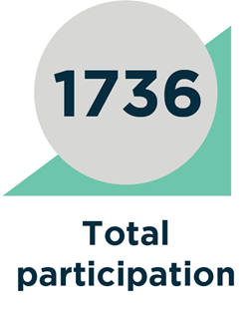
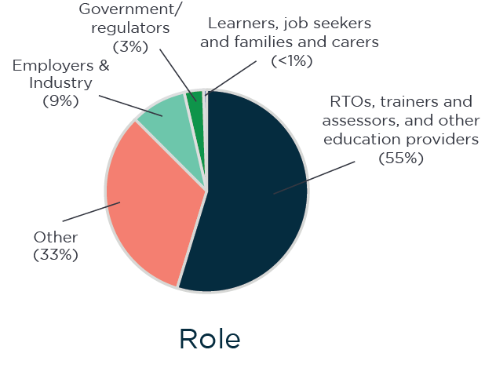

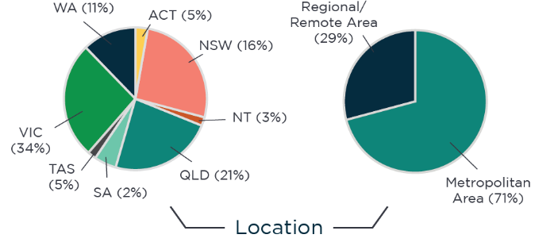
Consultations on qualifications reform
Participation overview
Two phases of consultations were undertaken from December 2020 to October 2021
The consultations identified benefits and opportunities to reform concepts which will more accurately reflect future skills and industry needs
Learners will have more transferable skills with improved access to recognition of prior learning supporting lifelong learning and career progression
Better recognition of micro-credentials and shorter forms of training
Reduction of duplication and complexity will allow a more navigable system
Whilst supportive of the reform concepts, stakeholders called for further detail.
This phase of consultation aims to provide additional detail of the proposed approach using draft templates and worked examples

Slide 5
Key principles for VET skill standards and credentials
Clear and relevant
Linked to skills needs and job standards defined by industry
Improved consistency and less frequency of updates required
Accessible
Information is usable, navigable, and meets needs of all users
Products clearly identify skills, knowledge and application
Flexible
Boosts labour market resilience
Less prescriptive, enabling innovation to address current and emerging skills needs
Transferable
Facilitates mobility between occupations, industries, and education pathways
Offers specialist and broader skills to align with workforce needs

Slide 6



Training product development process
Jobs and Skills Councils are responsible for the training product development process, working with industry, unions, training providers and relevant experts on the development of training products
Development process
Workforce needs
Careers and pathways
Skill Standards
micro-credentials
Workforce Needs
Job profiles
Job Profiles
Jobs and Skills Councils will identify skills needs, now and into the future, based on workforce planning using Jobs Skills Australia analysis
Jobs and Skills Councils will develop job profiles outlining functions required to perform various job roles in the relevant industry
Jobs and Skills Councils will map how people could move into and between roles and industries to support clear education, training and career pathways
Jobs and Skills Councils will develop a suite of Skill Standards to cover job functions outlined in the job profiles, with the broadest possible description of a job function in the workplace, covering key skills, knowledge and application
Training and Assessment Requirements
Collaboratively developed with educators, training providers and Jobs and Skills Councils the Training and Assessment Requirements to describe the mandatory performance, skills and knowledge requirements for delivery of Skill Standards
The model will retain features from the current system that are working well, such as qualifications underpinned by the Australian Qualifications Framework and nationally recognised micro-credentials in the delivery of Skill Sets
However, key structural elements will change—
Units of Competency will be replaced by Skill Standards as the new building block of training,
Training and Assessment Requirements will be separated from Skill Standards
Qualifications
Completion Rules
Jobs and Skills Councils will combine Skill Standards into industry recognised Qualifications or Skill Sets/micro-credentials in Completion Rules for delivery by training providers
Skill Sets
micro-credentials

Slide 7
Proposed training products
At the core of the proposed framework is the recognition that the articulation of a job function is inherently different to the practices of training and assessment
Skill Standards will replace Units of Competency
Developed by Jobs and Skills Councils, Skill Standards describe the skills and knowledge required to perform a job function in the workplace
Lifts the building block of training from a specific job task to a broader job function level
Will be industry-sector agnostic, supporting mobility of skills across multiple industries and job roles
Will have clear and consistent information, including a clear description of foundation skills
Separate Training and Assessment Requirements
Developed collaboratively by Jobs and Skills Councils, training providers and educational experts
Provides training providers with the information they need to deliver and assess competence against a Skill Standard in a specific industry context
Identifies the mandatory performance and assessment requirements and provides guidance for training provision
Completion Rules will package Skill Standards to qualifications or skill sets
Sets out the packaging rules for qualifications and skill sets
Provides the Australian Qualification Framework (AQF) level for qualifications
Provides information on entry requirements and training pathways for qualifications or skill sets

Slide 8
Skill Standards
Under the proposed VET model, Skill Standards will focus on the skills and knowledge needed by industry, promoting greater transferability where functions are shared by different Job Profiles.
Overview of Skill Standards
Skill Standards will be used to describe the skills and knowledge that are required by industry at a job function level. Cross-Sectoral Skill Standards will support automatic credit transfer where a job function is shared across industries.
The foundation skills and knowledge required to achieve competency will be consistently articulated within each Skill Standard.
Foundational Skill Standards will be clearly identified and will include assessor requirements similar to the current FSK Training Package.
Skill Standards
Industry Specific
Technical skill that can be used in one industry sector
Cross-Sectoral
Broader skill that can be used across two or more sectors
Foundation
Foundational skill that can be used by any industry
Industry-
specific
Skill Standards
Technical skill used in one industry or sector

Slide 9
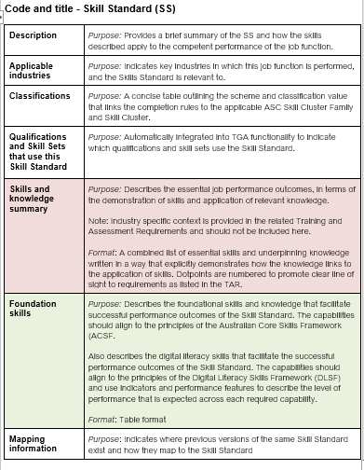
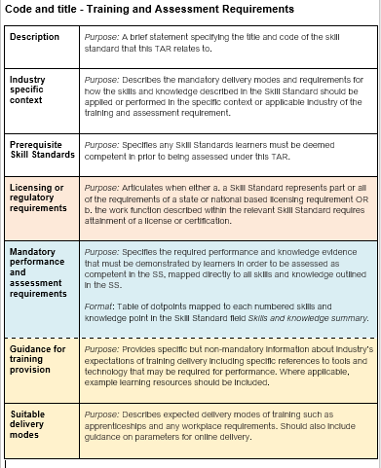
Key elements of the proposed Skill Standards and Training and Assessment Requirements
Skill Standards
Training and Assessment Requirements

Slide 10
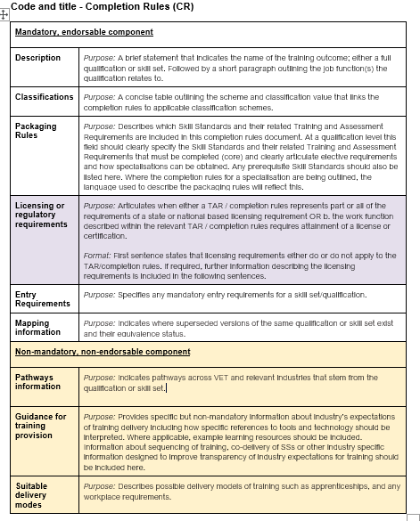
Key elements of the proposed Completion Rules
Completion Rules

Slide 11
Broader vocational qualifications for related occupations
In the current system, the majority of qualifications meet the needs of a single job role
In the new system, qualification design will recognise where skills and knowledge are common across related job roles
This will result in fewer discrete qualifications and will support greater learner transferability between job roles and industries
Specialised qualifications would be maintained where needed
Learners will achieve both broader vocational learner outcomes and job role specificity by combining:
  core training applicable to a group of related occupations
  specialisations aligned to a single job role within that group
Delivery of specialisations would be flexible to support inclusion in full qualifications, and standalone delivery as a skill set or micro-credential
Current occupation to qualification mapping
Proposed occupation to qualification mapping
Occupation 1
e.g. Organic farmer
Qualification A
e.g. Cert IV in Organic Farming
Occupation 1
e.g. Organic farmer
Qualification
e.g. Certificate IV in Agriculture
Core training
Specialisation A
e.g. Organic farming
Occupation 2
e.g. Agribusiness Manager
Qualification B
e.g. Cert IV in Agribusiness
Occupation 2
e.g. Agribusiness Manager
Specialisation B
e.g. Agribusiness
Occupation 3
e.g. Irrigation Controller
Qualification C
e.g. Cert IV in Irrigation Management
Occupation 3
e.g. Irrigation Controller
Specialisation C
e.g. Irrigation management

Slide 12


Example of the proposed model applied in Certificate III in Floristry
Current State
Proposed State
Certificate III in Floristry
6
Broad
Skill Standards identified
Certificate III in Floristry
Specialist Skills Standard
CUAACD201 - Develop drawing skills to communicate ideas
BSBDES301 - Explore the use of colour
40
Units of Competency
16
Core Units of Competency
Creative Design
Customer relations
Cross-sectoral Skill Standards
Sell to customer
SFLSOP008 - Provide quality service to floristry customers
And may also include entry requirements for foundation Skill Standards
SFLSOP009 - Sell floristry products
SFLSOP010 - Prepare quotations for floristry products
SFLSOP006 - Display and merchandise floristry products
SIRXMER202 - Plan, create and maintain displays
Stock handling
Work effectively
SFLSOP004 - Receive and store floristry stock
SFLSOP005 - Prepare and care for floristry stock
Specialist Skill Standard
Floristry Products and services
SFLSOP002 - Work effectively in floristry environment
BSBWOR202 - Organise and complete daily work activities
SFLWHS001 - Participate in safe work practices
Skill Standards at the job-function level promote labour market resilience and flexibility by recognising learners’ transferrable skills
SFLSOP003 - Recognise flower and plant materials
SFLDEC005 - Assemble floristry products
SFLDEC006 - Construct hand tied floristry products
SFLDEC008 - Construct floristry products with a base medium
SFLDEC007 - Construct wired floristry products
SFLDEC002 - Design floristry products
SFLDEC001 - Maintain floristry tools and equipment
SFLDEC012 - Interpret floristry design briefs
SFLSOP001 - Source information on floristry products and services
Cert IV
Cert II
Cert III
VET Qualifications in Floristry
Leadership
Small Business Management
Creative Design
Cross-sectoral Skill Standards
Customer relations
Sell to customer
Stock handling
Task-level recognition of competency is a barrier to recognising the transferable skills of learners, and their pathways to new occupations
Work effectively
Specialist Skill Standard
Floristry products and services

Slide 13
Example of the proposed model applied to the Pest Controller occupation
Current State
Proposed State – Certificate III
Qualifications mapped to Pest Controller
10 Cross-sectoral Skill Standards
Skill Standards are
aligned to job functions, not tasks
AHC30318 Cert III in Rural and Environmental Pest Management
Treat Facilities To Eliminate Pests
Licensing
5
VET qualifications
3
Australian Qualifications
Framework (AQF) levels
3
VET qualifications
3
Australian Qualifications
Framework (AQF) levels
Treat Greenery Or Surfaces With Protective Substances
Clean Facilities or Sites
CPP30119 Cert III in Urban Pest Management
Evaluate Reports Or Designs To Determine Work Needs
Estimate Maintenance Service Requirements Or Costs
Completion Rules
AHC41720 Cert IV in Pest Management
Supervise Maintenance Workers
Recommend Goods Or Services to Customers
Drive Vehicles To, Or At, Work Sites
CPP41619 Cert IV in Urban Pest Management
Document Work Hours or Activities
Inspect Buildings/Grounds to Determine Condition
Industry combines Skill Standards to build qualifications aligned to the AQF
AHC51316 Diploma of Pest Management
2 Specialist Skill Standards
Specialisation: Urban
Specialisation: Rural and Environmental
Pathways
Shared job functions
21 core Units of Competency in 5 Pest Controller qualifications
Occupational Profile: Commercial Cleaner
3
4 Units are core in other qualifications
17 Units are not core in any other qualifications
Occupational Profile: Pest Controller
4
Occupational Profile: Greenskeeper
3
Occupational Profile: Arborist
2 Units in working safely
Limited learner mobility and skills recognition
2 Units in chemical management
Recommend Goods Or Services to Customers
7 other occupations across different sectors

Slide 14
Learner journey through VET system
Transferable skills can be poorly recognised resulting in duplicative training that delivers similar skills to those the learner already has.
Learner obtains 4 qualifications over an estimated 10 years to gain employment in a management role
1st qualification
Learner enrols in 1st qualification that prepares them for specific job role
2nd qualification
Learner completes 2nd full qualification to prepare them for the new job role
3rd qualification
Learner enrols in an industry specific management qualification
4th qualification
Learner enrols in another industry specific management qualification
Current System
Circumstances change
Learner wants to move to a separate job role that uses similar skills to those that they already have
Loss of employment
Learner loses management role but another management job is available in another industry
Promotion to management
Learner is offered a management position within their job role
Re-employment in manager role
Learner gains employment in the new management job role
Employment
Learner gains employment in job that they trained for
Re-employment
Learner is now able to gain employment in the new job role
1st qualification
Learner enrols in 1st qualification that prepares them for a range of job roles, with a specialisation for a specific job role
Specialisation top-up
Learner completes a 2nd specialisation within the qualification they already hold in a micro-credential format
No training required
No need for retraining as the learner already has the requisite skills and knowledge needed for new management job
Proposed System
2nd qualification
Learner enrols in a management qualification that has broad vocational outcomes
Transferable skills are widely recognised, thereby ensuring that training is not duplicative and builds on skills that are already held.
Learner obtains 2 qualifications with 2 specialisation top-ups in an estimated 5 years to gain employment in a management role
14

Slide 15
Employer journey through VET system
Transferable skills are poorly recognised resulting in duplicative training that delivers similar skills to those the learner already has, and at a significant cost to employers
It is difficult to quickly address workforce needs, which results in lost productivity and costs to employers
Seeking qualified employee
Employer seeks suitably qualified employee to fill a skills need
Reskilling for a new role
Employer invests in employee to complete a 2nd qualification to reskill them, with significant overlap of skills and time spent off-the-job training
Employee seeks promotion
Employer invests in their employee to undertake a 3rd qualification in management skills within industry sector
Refilling vacant position
Employer seeks to onboard new employee or upskill existing employee with relevant industry specific qualifications
Filling management role
Employee is onboarded in management role after significant time spent completing industry-specific training
Current System
Circumstances change
Employer identifies new skills required for employee in current or future roles
Employment
Employer matches the employee to the job and onboards them
Transition to new role
Employee has the required skills to undertake the role
Promotion to management
Employee is offered a management position
Employee departs
Employee in management position leaves the business and replacement is sought
Specialisation top-up
Employer invests in employee to complete a 2nd specialisation within the qualification they already hold, reducing time away from work and costs to the employer
Seeking qualified employee
Employer will seek employee with the right broad vocational and specialised skills obtained from a qualification with a specialisation
Refilling vacant position
Employer seeks to onboard new employee who holds relevant qualification or and upskill an existing employee to complete a specialisation
Proposed System
Employee seeks promotion
Employer invests in their employee to undertake a management qualification that has broad vocational outcomes
Filling management role
A strong candidate is easily found, reducing the impact and expense on the employer
Transferable skills are widely recognised, providing employers with a wide pool of potential employees that can meet their workforce needs
It is easy to quickly address workforce needs as employee skills are broad with stackable specialisations
15

Slide 16
To submit a response to the Qualification Reform survey, go to: https://submit.dese.gov.au/jfe/form/SV_es9Ki5cpdkaDCsK
Thank you
19

