Slide 1
WorkFoundations
Paid Employment Pathways Program
User Journey

Slide 2
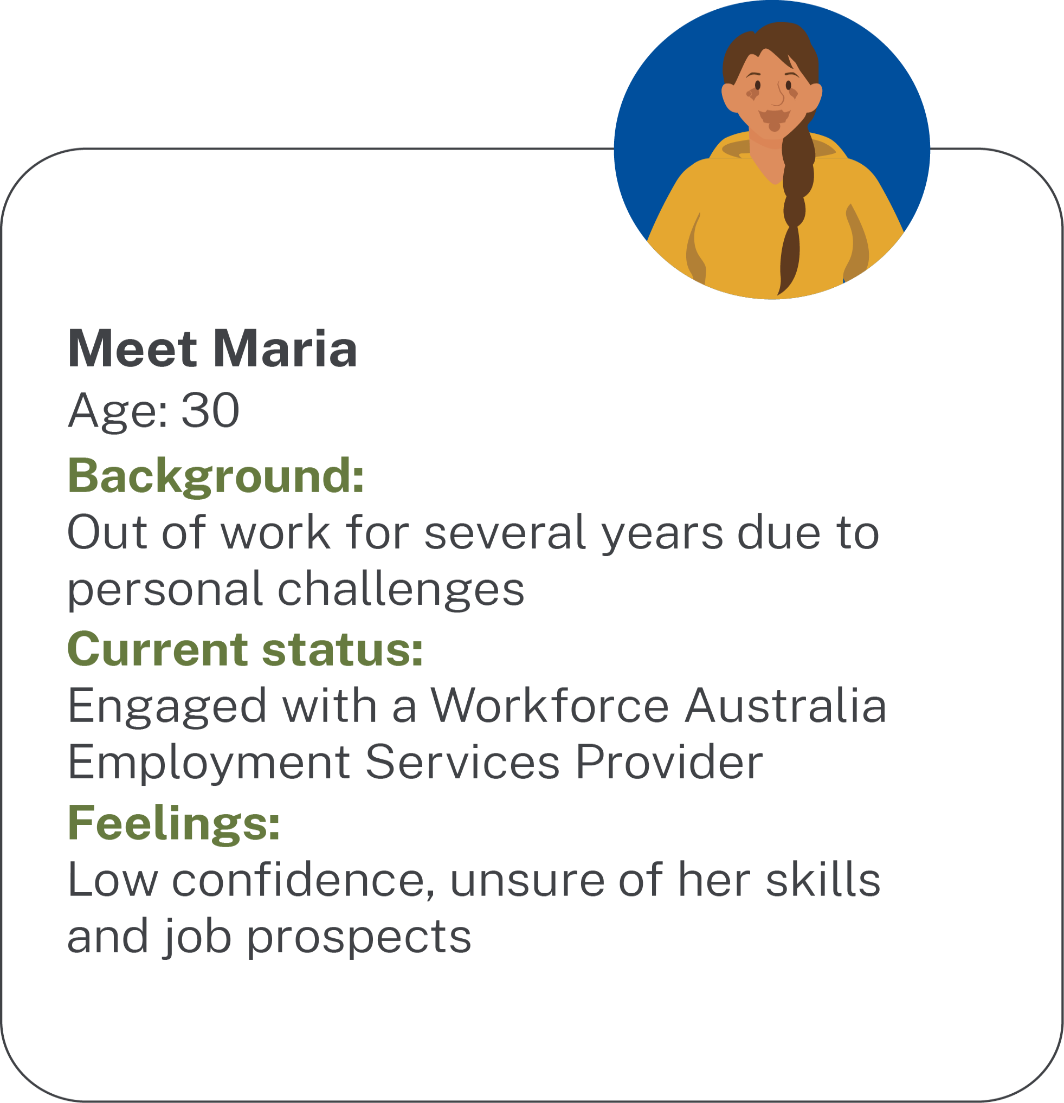
WorkFoundations Participant

Slide 3
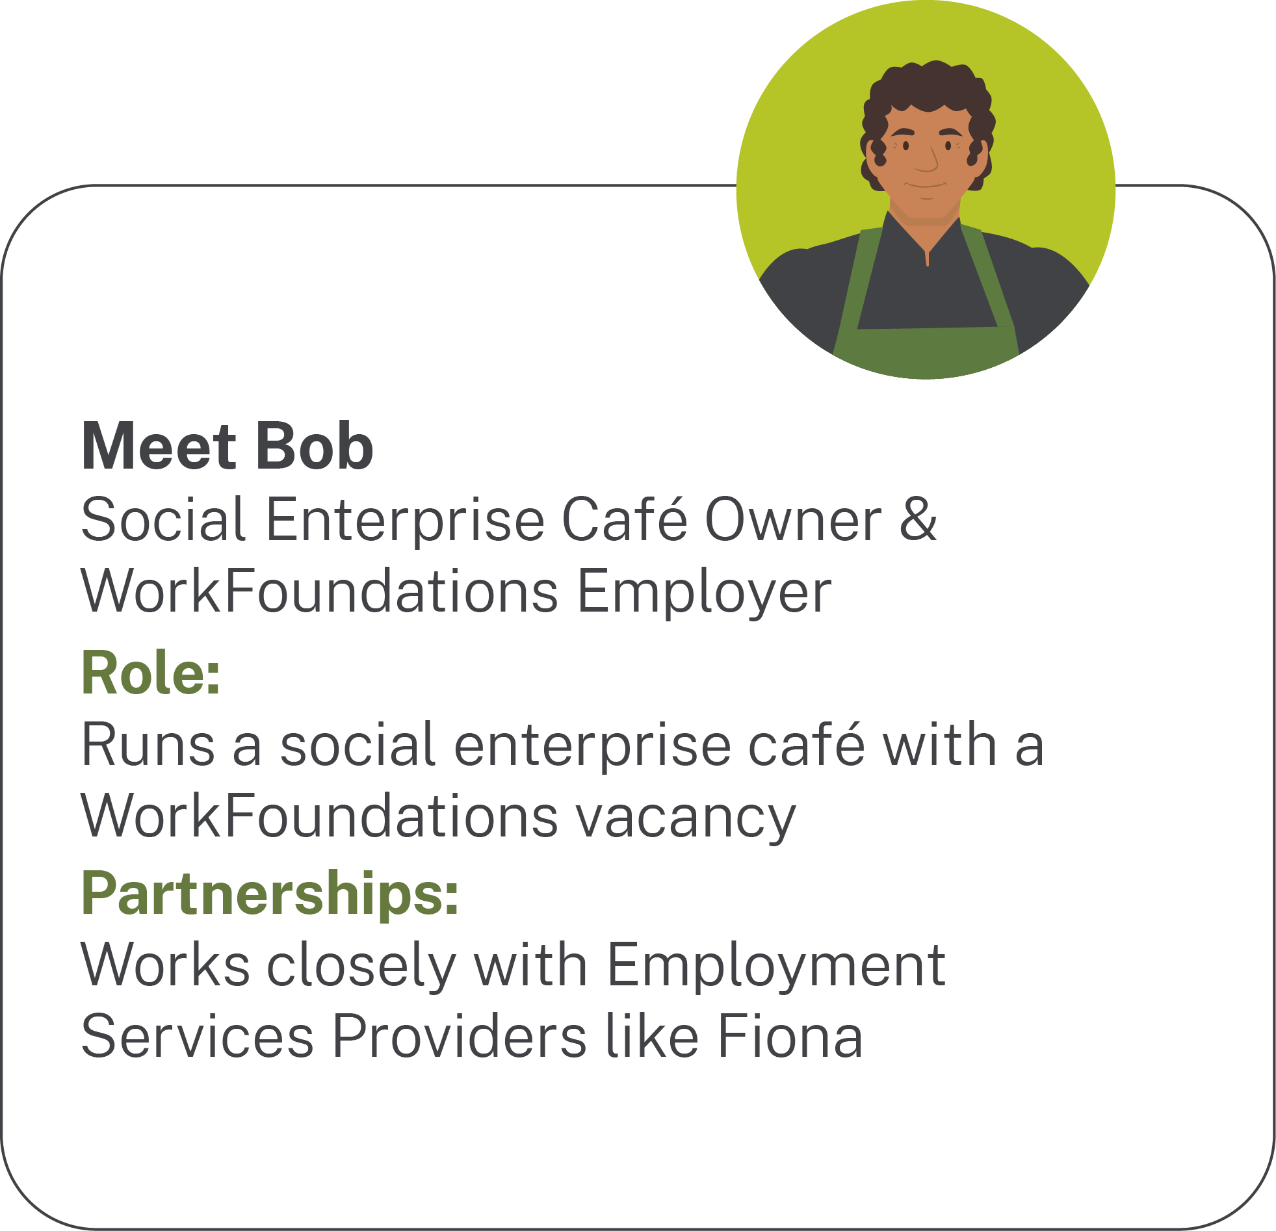
WorkFoundations Employer

Slide 4
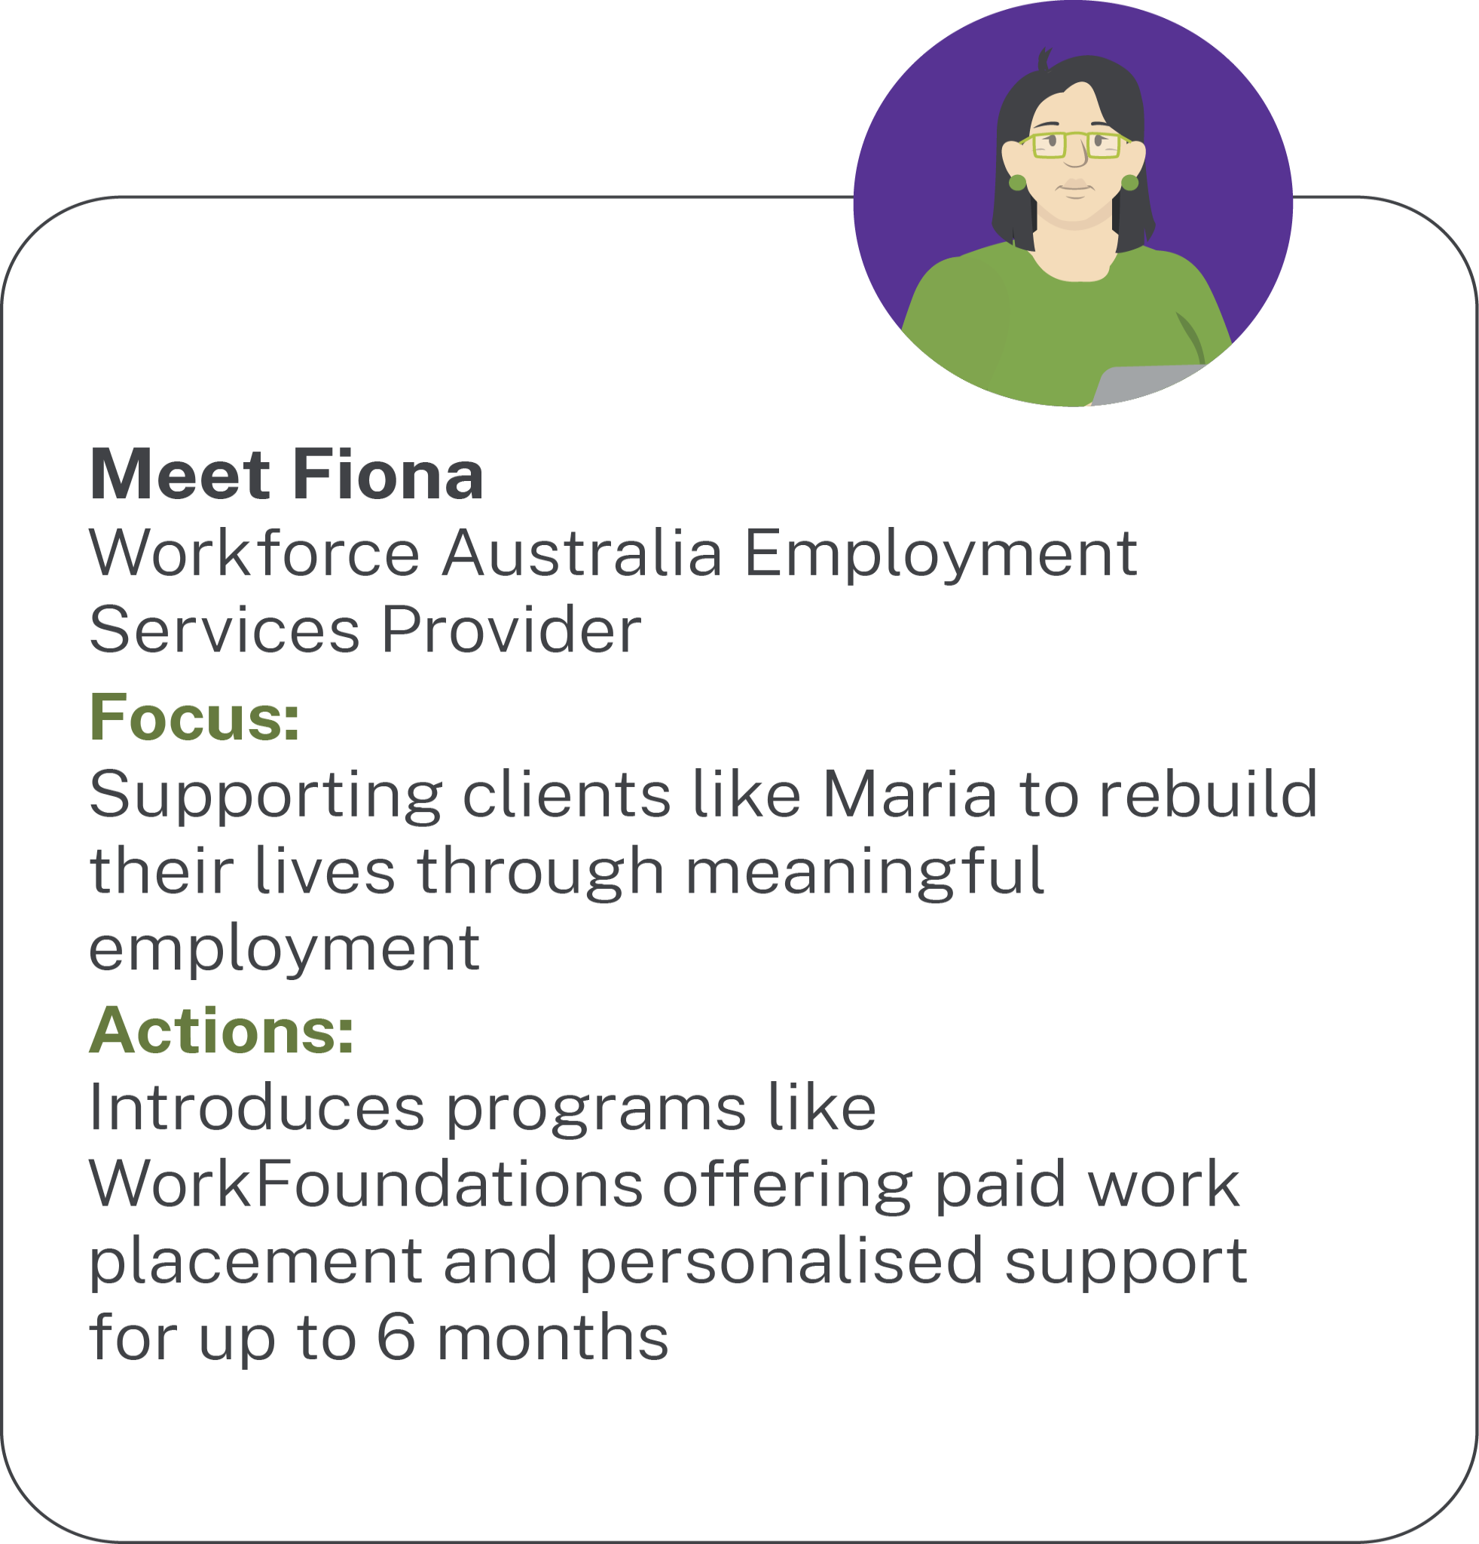
Employment
Service Provider

Slide 5
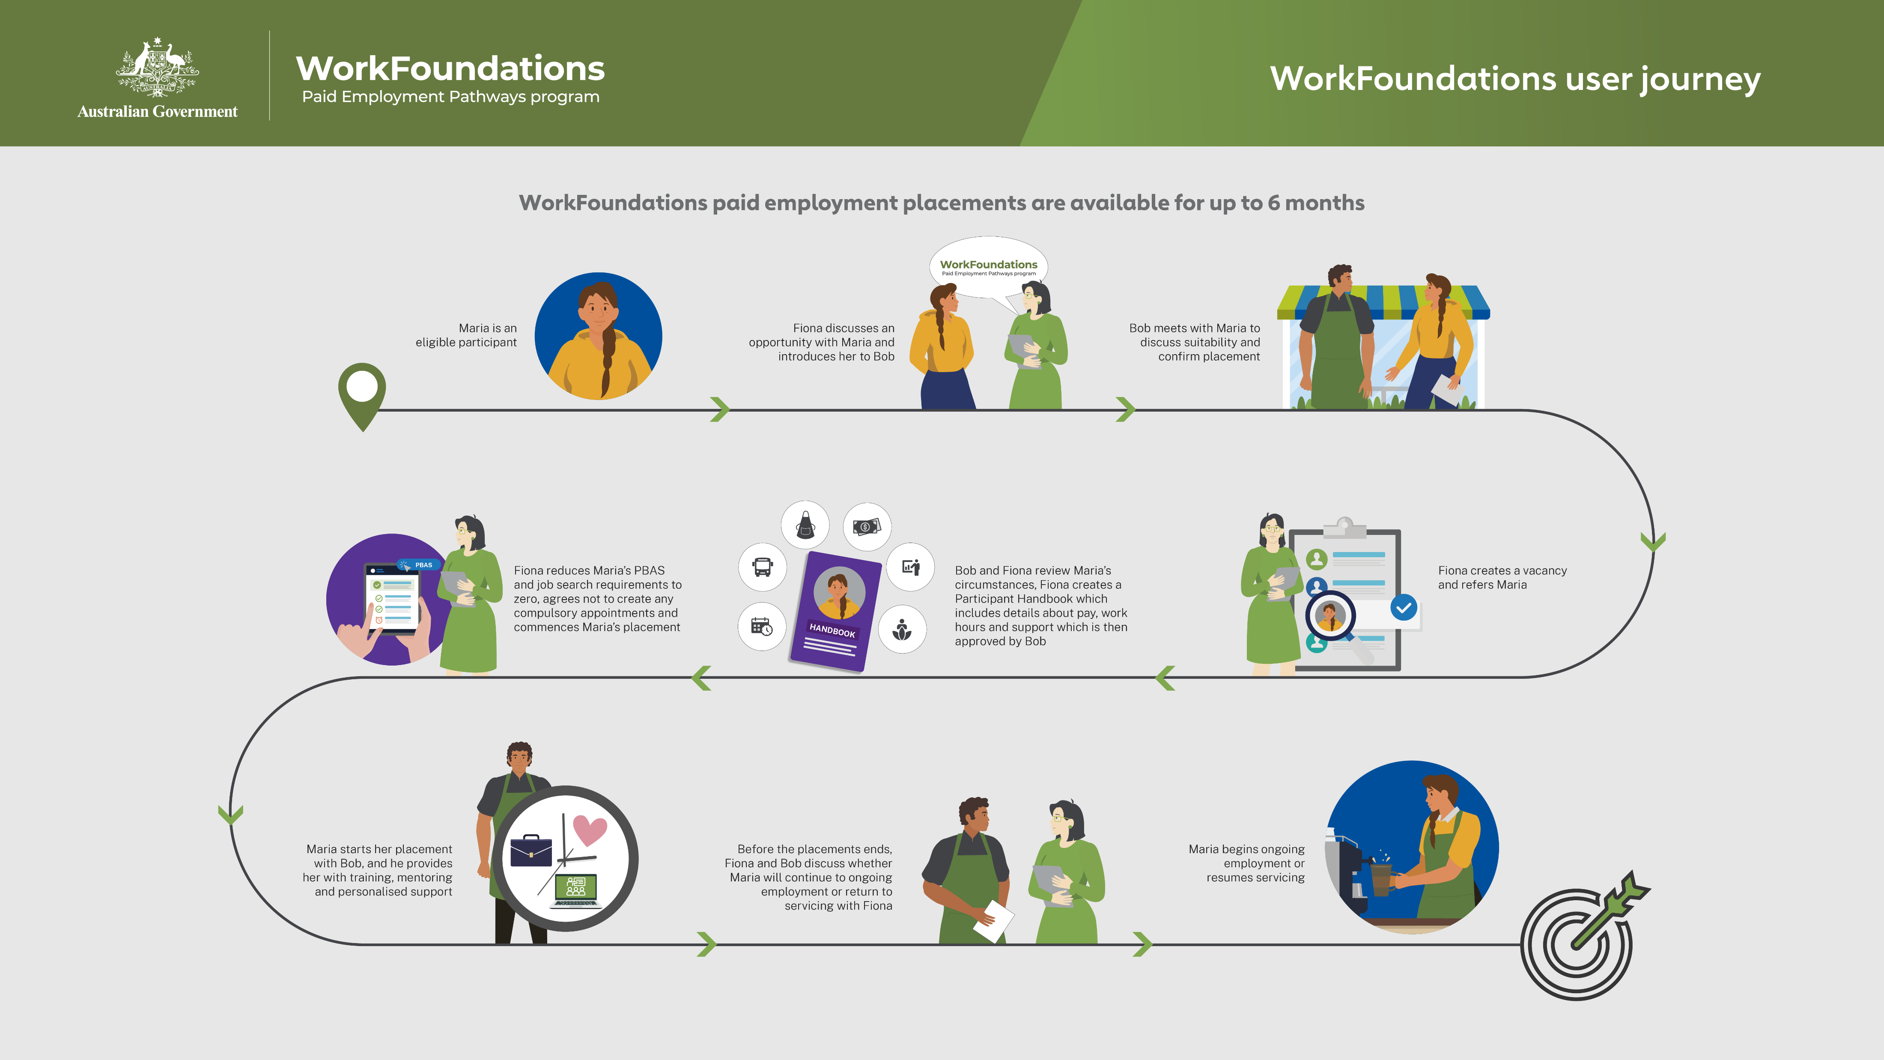
WorkFoundations User Journey Placemat

