Slide 1
Reforms to improve the quality of training delivery - Draft Standards for Registered Training Organisations (RTOs)
National forums – November to December 2022

Slide 2
Acknowledgement of country
We respectfully acknowledge the Traditional Custodians of the lands on which we are all meeting today.
We pay our respects to Elders and extend our thanks to all First Nations peoples who generously share their knowledge as part of this consultation.

Slide 3
Welcome and introductions

Slide 4
Purpose of workshop
Describe the reform context and why the Standards are changing
Describe the key changes in the draft Standards
Discuss what you think about the changes, and identify where improvements could be made

Slide 5
Context

Slide 6
Reform context
Industry Clusters
Improved industry leadership in the VET sector
Improved engagement of RTOs in training package development
Qualification Reform
Reduce over prescription in training products
Empower RTOs to deliver innovative employer-focussed training practices
ASQA Reform
Reforms to shift regulatory approach and improve engagement with the VET sector
A focus on self-assurance and excellence in training outcomes

Slide 7
What we’ve heard from the sector
RTOs report that being high quality means having:
governance structures committed to quality
a learner centred approach
strong local and employer networks
structures in place to ensure effective assessment processes
high-quality trainers and assessors with strong links to industry
Some limitations of the current system include:
overly prescriptive Standards and training products
Standards that are complex and difficult to navigate
Standards that focus on administrative processes
significant challenges in attracting and maintaining a high quality workforce

Slide 8
Revising the Standards
To ensure the sector’s focus is on high quality and innovative training, the Standards need to be clearly focussed on quality learner outcomes
In revising the Standards we aimed to:
Streamline the content and structure to enhance focus and understanding
Ensure requirements are clear and outcome focussed
Provide a clearer understanding of what high quality training looks like
Remove duplication and cross referencing
Address identified gaps in quality
Enable RTOs to evidence the outcomes in different ways
Balance flexibility to enable excellence and innovation while setting clear expectations

Slide 9
Structure of the DRAFT standards

Slide 10
The proposed structure – Quality areas and outcome statements
5 Quality Areas and each Quality Area has an outcome statement that describes the intent
Quality Area
outcome statements
Quality Areas

Slide 11
The proposed structure – Focus Areas
Under each Quality Area are Focus Areas that group like requirements together
14 Focus Areas
Outcome statements for each Focus Area – help to quickly identify the intention of the requirements under each focus area
Quality Area outcome statement
Focus Area outcome statements
Quality Area
Focus Areas

Slide 12
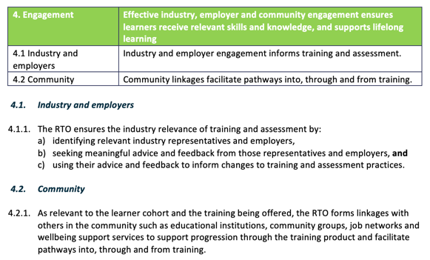
The proposed structure – Requirements sit under each Focus Area
There are 38 requirements
Quality Area outcome statement
Focus Area
Requirements

Slide 13
Key PROPOSED CHANGES in the draft standards

Slide 14
The draft Standards – the content
The intent of the draft Standards is that they:
are outcomes-focused to make it clear what needs to be achieved while enabling this to be tailored to each organisational context
are written in plainer language
are framed to accommodate the diversity of the sector
are simpler and easier to navigate because they have fewer technical definitions and less cross-referencing
are streamlined with fewer requirements
Today’s forum focuses on the foundational document that is the Standards, ensuring that the revised requirements are fit-for-purpose and are readily implementable and understood by RTOs

Slide 15
What’s been moved out of the draft Standards?
See page 11 and Part F of the consultation paper
Some existing clauses in the current Standards are proposed to be moved into other legislative instruments
Examples include:
the requirement to comply with the Data Provision Requirements (clause 7.3 of the current Standards)
the requirement to provide an annual declaration on compliance (clause 8.4 of the current Standards)
the detail of when transition is required to happen for superseded or deleted training products (clauses 1.26 and 1.27 of the current Standards)
requirements relating to AQF certification documentation and the AQF issuance policy (clauses 3.2 – 3.4 and Schedule 5 of the current Standards)

Slide 16
How do the draft Standards fit into the bigger picture?
Requirements for RTOs would be consolidated in three locations under the
NVETR Act, each with a different purpose:
This will be supported by clear guidance material
National Vocational Education and Training Regulator Act
Standards for RTOs
Guidelines
Compliance-based requirements
Outcome-focused requirements that go to the heart of quality training delivery
Enforceable Guidelines that operate alongside the Standards, setting out credential requirements and other matters
Important requirements that must be met to maintain registration

Slide 17
What’s different in THE draft STANDARDS?

Slide 18
Greater focus on quality of training and assessment
Stronger focus on the quality of training
Defining amount of training
Rewrite of the principles of assessment and rules of evidence for greater clarity and consistency of interpretation
A new requirement for pre-validation of assessment tools
Greater clarity about validation re the intended outcome of ensuring assessment tools and practices are fit-for-purpose
Safe facilities, resources and equipment
Clarity around recognition of prior learning (RPL) as an assessment process, and expectations on access to RPL
Standard 1 (Training and Assessment)
Outcome statement: Training and assessment enables learners to gain industry-relevant skills and knowledge

Slide 19
Greater emphasis on learner support
Refreshed list re information that needs to be given
Reviewing existing skills (LLN and digital skills)
Identifying training support services and providing access
Supporting learners through transition of training products, to minimise disadvantage
Reasonable access to trainers and assessors
Reasonable adjustments and flexibility re personal circumstances
Access to wellbeing support services
Equitable policies and practices re learner diversity including culturally safe training for Aboriginal and Torres Strait Islander peoples, safety for minors and other vulnerable cohorts
Clearer requirements re complaints policies
Standard 2 (Learner support)
Outcome statement: Learners are treated fairly and are properly informed, protected, and supported

Slide 20
Focus on building workforce capability and flexibility
Change to ‘understanding of current industry practices’
Improved capacity to engage industry experts and people working towards TAE qualifications to deliver training and assessment under the direction of a trainer or assessor
Use of Guidelines for credential requirements
Increased focus on PD and currency of training and assessment skills
Standard 3 (Workforce)
Outcome statement: Learners are trained and assessed by people who are qualified, skilled, and committed to continuous learning and development

Slide 21
Effective industry engagement and community linkages
Clarity about industry engagement including how that advice is used to inform training and assessment practices
Requirements for RTOs to form relevant linkages with others in the community
Relevant linkages depend on learner cohort and training
Includes linkages with educational institutions, community groups, job networks and wellbeing support services – focus on facilitating pathways into, through and from training
Standard 4 (Engagement)
Outcome statement: Effective industry, employer and community engagement ensures learners receive relevant skills and knowledge, and supports lifelong learning

Slide 22
Building stronger governance
Management accountability for compliance with the Standards (including compliance by third parties)
Leading a culture of integrity, quality training, safety, and wellbeing
Accountability re number of staff and risk management
Designed to promote learning and work environments that are supportive, inclusive, and free from discrimination and harassment
Financial viability and fit and proper person requirements embedded
Strengthened requirements relating to continuous improvement
Standard 5 (Governance)
Outcome statement: Effective governance ensures integrity of operations, commitment to quality delivery, and continuous improvement

Slide 23
Are there any other comments?

Slide 24
Summary and next steps

Slide 25
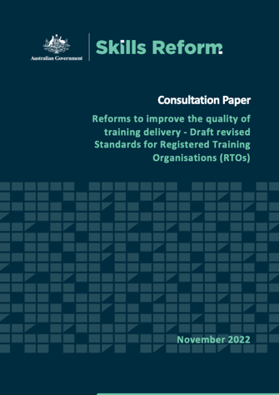
Next Steps
We are continuing the national forums until 9 December 2022
The consultation paper and online survey are available on the Skills Reform website:
www.skillsreform.gov.au/reforms/quality-reforms/
Consultation closes 31 January 2023
Email vetquality@dewr.gov.au if you need any assistance

Slide 26
Next Steps
Once consultation closes, we will:
refine the draft Standards based on feedback
engage with the states and territories and the VET regulators
Your feedback will inform:
changes to the draft Standards
consideration of changes to legislation
development of guidance materials
A summary of consultation and outcomes will be published on the Skills Reform website in early 2023
Revised Standards will be piloted with RTOs in 2023

Slide 27
Thank you

