Slide 1
Australian Apprenticeship Background Paper
This paper provides background information to support you to consider the questions outlined in the Australian Apprenticeship Services and Supports Discussion Paper.

Slide 2









What do employers tell us they need to succeed?
Employers and Industry are concerned by skills shortages in occupations for which apprenticeships are the main pathway. Strengthening Skills: Expert Review (2019)
The costs to employers of engaging and supporting an apprentice may be too high.
NCVER (2020)
Almost four in ten employers (39%) are concerned about the quality of training their apprentices receive.
Employers suggest the productive contribution of apprentices can be too low to be worth it – that is the training wage is higher than the value of the contribution and the incentives don't sufficiently offset.
Employers are concerned about timely access to training and are seeking more quality and flexibility from Registered Training Organisations
Employers would like greater assurance that their investment in an apprenticeship will provide longer-term returns, (this includes staying with the employer over the apprenticeship and post completion).
Employers and industry are keen to streamline processes associated with taking on an apprentice - Hiring and sign-up processes should be easier
Apart from wages supervision costs are often the most expensive apprenticeship cost for employers aside from wages – the costs are front loaded to the early years and decline over time.
Industry continues to seek increased financial support and services for employers taking on apprentices.
Productivity Commission: National Agreement for Skills and Workforce Development Review 2020
Departmental research 2021

Slide 3











What do apprentices tell us they need to succeed?
Apprentices value personalised assistance to manage mental health and workplace issues, with regular contact from a trusted advisor
Apprentices are concerned about low wages and their ability to meet the cost of living.
Low wages are a barrier to taking up or staying in an apprenticeship. 35 per cent of apprentices find the low level of pay challenging, especially during the first year. Apprentices reported seeking food from charities, selling vehicles and relying on partner and parental support to make ends meet.
Personalised assistance including mental health supports - Apprentices need and value non-financial and mental health supports.
Keeping apprentices engaged is critical to improving completions - 80% of the time, the decision to cancel an apprenticeship is made by the apprentice.
Behavioural research shows apprentices value ongoing advice on their rights and responsibilities, and access to timely assistance to help them resolve workplace issues
Source: Increasing completions of apprenticeships and traineeships using behaviourally informed messages – NSW Government March 2021
In a tight labour market apprentices have options - moving for more pay or dissatisfaction with the workplace are the most common reasons for leaving.
“The first week is a bit of a blur… it would have been good to have more follow-up the first year to have an understanding of what is going on”
Labour shortages mean that unskilled work is paid at higher levels than training wages - Australia’s record low unemployment has given more apprentices the flexibility to discontinue their training.
“Wellbeing should be an industry wide priority but especially apprentices [sic]. The type of work we do and the hours we do, it’s hard without a social life. It isolates you and wears you down. Someone to go to talk to would be amazing. Talking to peers helps.”
Support in the workplace and good work conditions - ‘You have to have a good mentor in the workplace…. It makes life so much easier. Someone who is willing to share their knowledge.’

Slide 4




26.6% of apprentices cancel in the first 12 months but there is evidence of strategies that make a difference
From May 2019 to November 2019, the NSW Behavioural Insights Unit worked with Training Services NSW (TSNSW) and the Centre for Education Statistics & Evaluation in the Department of Education to send behaviourally informed personalised text messages to learners.
The messages were designed to encourage them to seek help when they needed it and persevere during their apprenticeship or traineeship.
13,065 first year learners were randomly assigned into three groups:
One third of learners were sent six SMS about how to build self-efficacy and get a ‘fair go’ at work (e.g. seeking mentorship, finalising their training plan, and other workplace rights).
One-third of learners received six SMS about incentives (e.g. travel concessions, pay progression, and early completion). Both groups were sent a link to visit the Training Services NSW website for resources to help them persevere with their training, or they could get further help by calling their local Regional Office.
The other third of learners did not receive any SMS (the control group), however, they still had access to the same online resources and support from their local TSNSW Regional Office.
The cancellation rates for learners who received the Fair Go message was 2.8 percentage points lower than those who received no SMS. The Fair Go messages were also more effective than those who received messages about Incentives.
• If NSW sent the Fair Go messages to all 13,100 first year learners around NSW, an additional 370 learners will continue their training.
• The texts also led to 552 direct phone calls and 512 text messages, plus almost 6,000 clicks to TSNSW resources.
Results demonstrated a decrease in cancellations and improved apprenticeship engagement.
NSW have taken learnings from this pilot to inform the current support for all first-year apprentices.
Source: increasing completion of apprenticeships and traineeships using behaviourally informed messages – NSW Government March 2021

Slide 5



Apprenticeship stock numbers (in-training)
Current in-training numbers have consolidated since the 2012-13 policy change that reset the trade/non-trade balance of traineeships and apprenticeships
There are currently 387,830 apprentices and trainees in training as at 31 March 2022
In-training data is a point in time measure that can be compared to the same period in previous years.
In-training data includes all active apprentices at various stages in their apprenticeship.
In-training numbers have consolidated since 2012-13 and the overall system is at capacity.
Source: NCVER 2022, Australian vocational education and training statistics: apprentices and trainees 2022 — March quarter
​‌OFFICIAL‌​

Slide 6



Apprenticeship in-flows (annual commencements)
234,700 Australian Apprentices commenced in the 12 month period to 31 March 2022.
Commencements by year from 2013
Commencement numbers represent apprentices signing their first training contract.
NCVER commencements are a quarterly or annual measure.
Prior to the COVID-19 wage subsidies, overall commencement numbers had been declining year on year, particularly in non-trade occupations.
A recommencement represents apprentices signing a second or subsequent training contract in their journey to complete their apprenticeship/traineeship.
Source: NCVER 2022, Australian vocational education and training statistics: apprentices and trainees 2022 — March quarter

Slide 7
Programs and Services

Slide 8
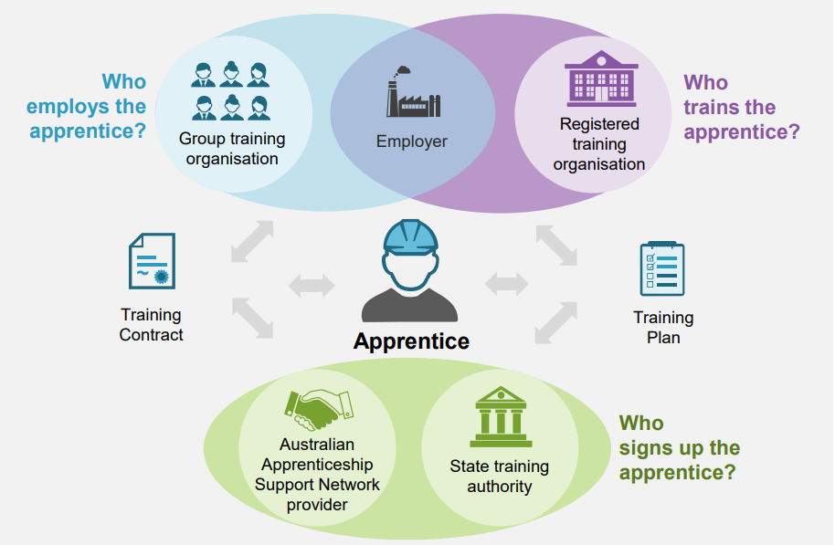
Key Services Supporting Australian Apprentices
Commonwealth and State Governments contribute to support services available for employers and apprentices.
Both levels of government provide a range of incentives and services across the various stages of the apprenticeship
Training contracts set out responsibilities for the apprentice and employer, details of the qualification and the selected RTO. RTOs are responsible for the formal components of training, conduct assessments and issue qualifications.
Australian Apprenticeship Support Network (AASN) Providers administer the signing of all training contracts which are then registered and regulated by the relevant State Training Authority (STA)
In taking on an apprentice employers commit to the provision of supervision, on-the-job training, appropriate pay and work conditions, and support to attend any off the job training.
Productivity Commission - National Agreement for Skills and Workforce Development Review - page 330

Slide 9

Roles and responsibilities in the Australian Apprenticeship System
COMMONWEALTH
STATE AND TERRITORY
EMPLOYERS AND INDUSTRY
The Commonwealth provides a range of financial supports to employers and apprentices to assist them with the costs of hiring an apprentice. Supports include a mix of services and financial support programs, including:
Contracted apprenticeship advice and assistance to prospective apprentices, new employers, schools and industry groups, as well as ongoing support to apprentices and their employers over the life of the apprenticeship.
Financial support programs include wages subsidies, incentive payments, income contingent loans, targeted incentives for industries and living away from home allowances
The Australian Apprenticeships Incentives System, valued at $2.4 billion over 5 years, is strengthening the apprenticeship system to target skill shortages, improve completions and ensure supports are accessible.
This is on top of the grandfathering of the former Australian Apprenticeships Incentives Program which brings total existing Commonwealth investment in the apprenticeships system to $6.5 billion to 30 June 2026.
States and territories are responsible for regulation of Australian Apprenticeships and training delivery. This includes approving training contracts, deciding which RTOs can provide training and which qualifications can be completed as an apprenticeship and the duration of training.
States and territory governments manage separate apprenticeship support programs based on the needs of the specific jurisdiction, for example procurement targets, tax rebates and direct apprentice allowances. These supports can overlap and complement Commonwealth funding.
States and territories also subsidise the formal RTO training, determining which qualifications are eligible for a subsidy and which individuals can access it.
Industry is responsible for managing training packages, working with the government to inform policy and providing assurance that incentives are fit for purpose.​
​
Employers are responsible for delivering on the job training and supervision. They take on apprentices to invest in their business and grow their qualified workforce. The employer can train the apprentice in skills and processes suited to their business. ​
Employers benefit from employing an apprentice through the skilled labour they provide and the opportunity to retain them after the apprenticeship is completed
Top reasons for taking on an apprentice (NCVER 2019)

Slide 10

Australian Apprenticeships Incentive System (Incentives System)
The Australian Government has provided financial assistance to employers and apprentices in the form of payments and wage subsidies since the 1960s. Incentives provided to employers aim to assist with cost of employing, supervising and training an apprentice, while support provided to apprentices aims to assist apprentices with the cost of living, particularly in the early years when training wages are lowest.​
Current Incentives System​
The current Commonwealth Incentives System commenced on 1 July 2022 with a focus on strengthening and simplifying the apprenticeship system to target skills shortages, improve completions and ensure supports are accessible.
​
There is support for all employers of Australian Apprentices​
Support is available to all employers taking on Australian Apprentice. If the apprentice is in an occupation not listed on the Priority List, the employer can access a Hiring Incentive of up to a maximum of $3,500 and paid in two six-month instalments.​
Additional financial support is available for Priority Occupations​
The focus of incentives toward priority occupations, and a direct payment to the apprentice, encourages apprentices to take up occupations where there is current and future skills demand while also creating a pipeline of skilled workers to meet the needs of employers and industry.​
The Incentives System has been designed to improve retention and completion rates for apprentices, particularly in priority occupations, through a combination of financial and non-financial supports, including:​
        a wage subsidy for employers of Australian Apprentices in priority occupations, set at 10 per cent in the first year of the apprenticeship, 10 per cent in the second year and 5 per cent in the third year (up to a maximum of $15,000); and​
        a direct payment to Australian Apprentices in priority occupations, set at $1,250 paid every six months for the first two years of the apprenticeship, (up to a maximum of $5,000).

Slide 11




NSC Skills Priority List - Informing investment
  The Skills Priority List (SPL) is based on evidence
An occupation’s current labour market rating is determined through labour market statistical analysis, employer surveys, peak and representative body input, federal and state/territory government input and other data and evidence, where available.
NSC Skills Priority List
  Development and Consultation
The NSC has primary responsibility for identifying occupations in skills shortage, along with potential future demand across the Australian labour market. In October 2022, the NSC updated the Skills Priority List (SPL) which provides a current labour market rating and a future demand rating for 799 occupations from skill levels 1 – 4.
The SPL was informed by stakeholder consultation on the Review of the National Skills Needs List (NSNL). The NSC engages with peak bodies, industry groups, professional organisations, unions and regional representative bodies on the development of the SPL, including twice-yearly online surveys and face-to-face (or online) engagement with representative bodies year-round.
  Used to inform a range of skills programs
The SPL is used to inform a range of skills programs, including Australian Apprenticeship programs, Skilled Migration and JobTrainer which delivers low fee or free training places in areas of skills need.

Slide 12

Supplementary programs help to deliver targeted wraparound support, to help apprentices to navigate the system and address additional barriers
Trade Support Loans (TSL)
Government funded concessional loan to support the apprentice through training.
Up to $22,890 available over the life of the apprenticeship.
Youth Support
Additional In-Training Support places for Apprentices aged 15-20
Check in call at three months after commencement
Disability Australian Apprentice Wage Subsidy (DAAWS)
Incentive payment to employers of eligible apprentices with disability.
Women in Trades (with low female participation) receive:
Guaranteed Gateway Service and ITS places
Specialist mentors, networks and entrepreneurship training
New Energy Apprenticeships
10,000 New Energy Apprenticeships over four years
Up to $10,000 per apprenticeship
Living Away From Home Allowance (LAFHA)
Allowance for eligible apprentices living out of home during their apprenticeship

Slide 13




A modern IT platform is transforming administration
Technology is enabling user focused service delivery and more current data
Delivery of the Australian Government’s apprenticeship program and services is being transformed through the introduction of a new IT system, Apprenticeship Data Management System (ADMS). ADMS launched in April 2022, delivering a new technology solution to support apprentices, employers and STAs. It enables employers and apprentices to engage directly to claim wages subsidies and payments, providing them with greater access to their own records and information.
ADMS is replacing a 20-year-old IT system, which has required contracted providers, to perform data entry, claims processing and manual reporting, with inefficiencies and duplicative data entry to be phased out by the new system. ADMS enables all contributors to the apprenticeship experience to dedicate less time to administration and more time to providing high value services and creating better outcomes.
ADMS will improve the user experience for all apprenticeship stakeholders and enable more targeted policy decisions by:
Providing simple tools to monitor and track progression of an apprenticeship and manage personal user profiles.
Enabling the monitoring of payments and debts related to an apprenticeship
  Reducing AASN providers focus on claims processing and administration allowing an increased focus on the provision of advice, assistance and wraparound services
Connecting Commonwealth and State Government processes, allowing better data sharing in near-real time
Providing Government with a better understanding of the full apprenticeship ecosystem through improved analytics
  Ensuring smarter tracking of apprenticeship obligations

Slide 14







Australian Apprenticeship Support Network Providers
There are 7 AASN Providers contracted directly by the Commonwealth Government.
  Contracted by state (with exception of WA) the AASN network provides national coverage
  In the Northern Territory, GTNT is contracted to deliver services on behalf of both the Commonwealth and the Northern Territory government, while in Qld AASNs are also contracted separately to provide some additional services to apprentices and employers by the Queensland government.
  Collectively providers employ around 500 mobile field officers and operate out of 130 full time sites
For the 12 months to March 2022 AASNs managed 234,700 sign-ups and supported 387,830 apprentices in training.
MEGT
QLD
NSW
VIC
TAS
SA
Perth
Chambers Apprenticeships Support Australia
VIC
NSW
Perth
Outback WA
Sarina Russo Job Access
QLD
NSW
ACT
VIC
BUSY at Work
QLD
Torres Strait
Perth
Outback WA
MAS National
VIC
QLD
TAS
SA
VERTO
NSW
GTNT Group
NT

Slide 15
Summary of AASN Services
Designed to complement and support state and territory-based services, this national provider network is contracted by the Australian Government to provide the following services to apprentices, employers and industry:
The key goal of the AASN program is to make it easier for employers to recruit, train and retain Australian Apprentices and to support Australian Apprentices through to completion by:
simplifying and improving user access and engagement with the Australian Apprenticeships system by establishing Network Providers as hubs for the delivery of quality end-to-end advice and support services for Australian Apprentices and their employers;
providing targeted support to Australian Apprentices and employers prior to commencement and while in-training; providing services to assist individuals to find the right Vocational Education and Training (VET) pathway or employment pathway for them; and
minimising the administrative burden on employers and Australian Apprentices.
Gateway Services (pre-apprenticeship advice for apprentices and employers)
Pre-commencement advice to potential Australian Apprentices and employers.
Providing recommendations for apprentices into the right training or employment pathways
Matching individuals with compatible employers.
(30,000 places per annum)
Universal Services (broad based support and administration)
AASNs are responsible for marketing and stakeholder engagement of apprenticeships.
This includes promoting apprenticeships as a pathway to gain skills and qualifications, as well as to assist employers and industry to develop a skilled workforce.
All training contract sign-ups are attended and processed by an AASN provider. Under this service, AASNs provide advice and assessment on eligibility for support and incentives to employers and apprentices.
In-Training Support (ITS) (support and mentoring)
Personalised support to apprentices and trainees at risk of not completing their training.
Particularly important for disadvantaged or at-risk cohorts.
Services provided are based on assessment of individual need and may include pastoral care, mentoring, counselling, career guidance, industry mentoring, conflict resolution and referral to other specialist services.
(30,000 places per annum)

