Slide 1
New Employment Services Model
Provider Forum
John Dardo
June 2021
Notes:
Our priority is to roll out a new Employment Services Model that assists a range of stakeholders including employers, job seekers, providers and Government.
What I really want to focus on and one of the most critical outcomes we are looking for is that we need to refocus provider effort to job seekers with higher needs.
We need to create capacity for that to happen, because there is a significant risk with the effort that needs to go into providing those job seekers with the support they need to get them into as close to full employment as possible or as practicable given their personal circumstances.
There are some very specific outcomes we are looking for, including:
for employers, making it easier to source the right job seekers
for job seekers, we want a more personalised and more flexible model
for providers, there will be a new licencing system that rewards high performing providers and gives them more certainty, but also a caseload that focuses on the higher needs job seekers rather than the job ready job seekers
for government, we need to make sure that we are more capable of delivering a responsive model.
This presentation will be made available to you and will also be published online.

Slide 2
Agenda
  Part 1: Recap from CEO Forum
Part 2: Engagement Approach
Part 3: Improving provider experience
Part 4: Security & Accreditation
Part 5: Future opportunities
2
Notes:
You can see today’s agenda up on screen.
But firstly, a note about probity.
The department is committed to conducting a fair & transparent process for the procurement of services for the new model– you have likely heard this referred to as ‘probity’.
As we are entering into the implementation of the model involving a Request for Proposal process through an open tender for the engagement of Employment Service Providers, we are in a probity environment.
When we talk about ‘probity’, we mean acting with:
integrity
fairness
uprightness
honesty of processes.
The department has created a NESM Probity Plan which has more information about the individual principles & protocols that we are applying to managing probity in relation to the NESM.
All of our staff working on the new model have also gone though probity training.
What this means for you is that we will be ensuring every single process we enter into is fair, equitable & transparent.
This includes making sure that detail we share with one potential supplier of Employment Service Providers is shared with other potential suppliers. For example, if we answer a direct question that could give one potential supplier an advantage, we must ensure it is available to other potential suppliers.
You might note that while some of our Forums are usually with those who have a jobactive contract (e.g. the CEO Forum) today’s forum is open.
It will also be livestreamed/recorded so as to ensure we are not unfairly advantaging any potential supplier
Copies of this presentation will also be made available following today’s session.
Also in all of our interactions, please be aware that we want to be as open as possible & to answer any questions you might have, but there may be some subjects or questions that are off limit.

Slide 3
Part 1: Recap from CEO Forum
Part 1: Recap from
CEO Forum

Slide 4




The Vision
We envision a digital, personal, and effective employment services system that:
  Assists employers to source skilled job seekers
Supports eligible job seekers to find a sustainable job
  Focuses high performing providers on supporting higher need job seekers
  Creates a more efficient and cost-effective model for government
4
Notes:
Based on the reforms announced in 2019 and the Expert Advisory panel’s report, a NESM vision was created.
These are the four pillars of the NESM Vision Statement.
The vision statement provides a single source of truth and consistent messaging about what NESM is and how it is being implemented.
Our Vision is that the New Model will:
Provide a valuable service for employers that provides them with candidates that have the skills they need.
Supports eligible job seekers to the right support through digital or provider-led services based on need.
Refocuses providers on supporting high need job seekers into sustainable employment by redirecting job ready job seekers into digital servicing;
Increases cost-effectiveness and evidence base for policy and program improvement for the government. We want to make sure tax payers money is being spent well by directing it to those that need assistance.

Slide 5
The new model will deliver key improvements for all
  Employers
Job seekers
Providers
Government
  Better sourcing of job seekers who meet employers’ skill & job needs.
  Reduced administration & red tape to simplify & accelerate the recruitment process.
More personalised & extensive support, including skilling & job pathways.
A new flexible activation framework to improve the effectiveness of mutual obligations & increase personal responsibility.
  A new licensing system that allows for specialisation & rewards high performing providers.
Reduced caseload due to job ready job seekers using Digital Services.
A more focused system with resources & incentives targeted to improving outcomes for higher need job seekers.
Agile service delivery model that can be more responsive to changing labour market conditions & policy needs.
Notes:
The new model will deliver key improvements across employment services for all stakeholders:
Employers – it will provide a valuable service through:
better sourcing of job seekers who meet employers’ skill and job needs
reduced administration and red tape to simplify and accelerate the recruitment process.
Job seekers – it will align job seekers to the right skilling and job-seeking support through digital or provider-led (enhanced) services that bring:
more personalised and extensive support, including skilling and job pathways
a new flexible activation framework to improve the effectiveness of mutual obligations and increase personal responsibility.
Providers – the new model will allow providers to support job seekers needing the most assistance into employment by redirecting job ready job seekers into digital servicing through:
a new licensing system that allows for specialisation and rewards high performing providers
reduced caseload due to job ready job seekers using Digital Services.
Government – the model increases cost-effectiveness and evidence base for policy and program improvement, providing:
a more focused system with resources and incentives targeted to improving outcomes for higher need job seekers
agile service delivery model that can be more responsive to changing labour market conditions and policy needs.

Slide 6
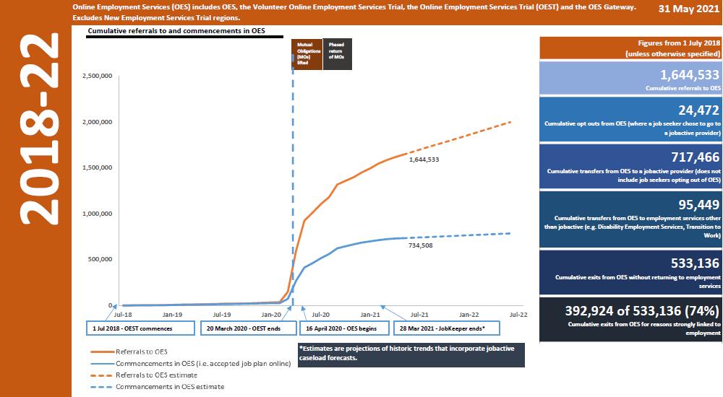
Job Seekers accessing Online Employment Services
Job seekers accessing Online Employment Services (cumulative)
Data to be updated
6
Notes:
Because of COVID, we have brought forward the delivery of online employment services and are already in production, though not to the level of building functionality that we will have next year.
The online employment services will at least be available to people who go on income support and are assessed as being capable of using the online employment service.
You can see that on the graph that six million people have been referred to employment services and most of the referrals occurred when COVID struck. We needed to come up with different ways to service the growth in job seekers.
Cumulatively there have been almost 25,000 opt outs, where a job seeker has chosen to go to a provider.
Separate to these, we’ve seen, cumulatively, 700,000 people transferred from online employment services to a provider.
I’d also flag that we’ve had 533,000 people that have exited online employment services without touching a provider and of those 400,000 exited for reasons linked to employment.
As you can see, the model is not complete but is already in production. We already have a large wealth of information about client experiences based on the model being in production.

Slide 7
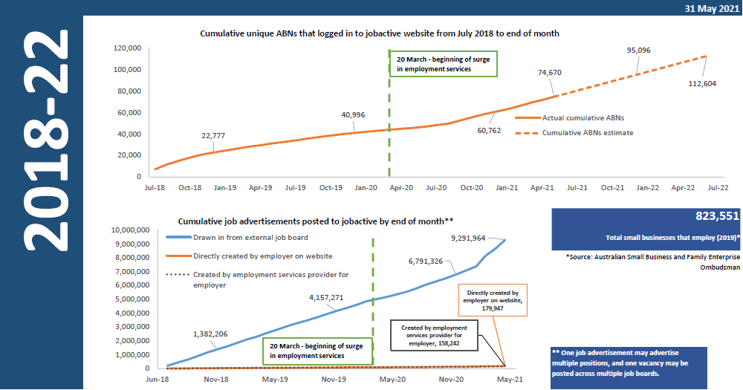
Employers accessing Online Employment Services (cumulative)
Employers accessing Online Employment Services (cumulative)
7
Notes:
The other side of the employment service are the employers that are accessing online employment services.
Cumulatively we have had about 75,000 thousand ABN’s that have directly advertised a job.
We have had nine million vacancies that were made available on online services, the overwhelming majority of those vacancies were made available via online advertising providers. This means that most of those vacancies are coming from online ads that are being republished in online employment services.
In the next few weeks we will be meeting with some of those online advertising providers to talk about what the world will look like in the future, what services they would use from us and what services we would use from them.

Slide 8
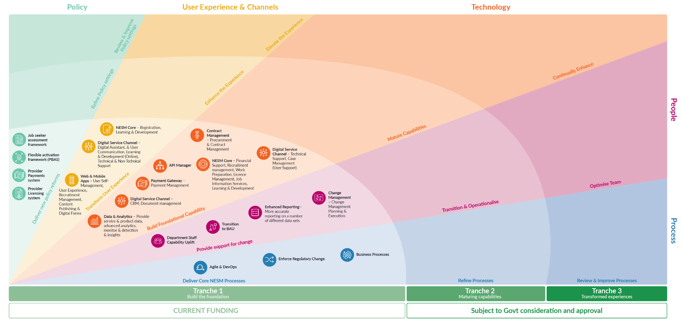
NESM Delivery Across Three Tranches to enable continuous improvements
NESM Delivery Across Three Tranches to enable continuous improvements
NESM Core capabilities are prioritised into key initiatives delivered over three tranches.
Tranche 1 delivers the foundation for continuous improvement in the subsequent tranches.
8
Notes:
We are funded with a clear set of deliverables over the next 12 months, up until 30 June 2022.
Our program of work is relatively clear with some detailed designs still to be worked through.
We know what we need to build, when we need to build it and when it needs to released.
There is an opportunity for us to keep building on that program of work in the future and to keep reimagining what happens beyond 30 June 2022.
I think that’s the discussion I really want to engage in with this group, as well as some other groups including Employer forums, over the next few months.

Slide 9





Outcomes progressively released to July 2022
Outcomes progressively released to July 2022
 | From | To
Individuals (Job seekers) | All job seekers referred to providers unless part of a digital trial | Job seekers assessed online & self manage unless they opt out or assessed as disadvantaged
 | Digital job seekers referred to activities through the contact centre | Digital job seekers discover & self-refer to eligible activities to meet mutual obligations
 | Job seekers are referred to online services prior to completing assessment | Job seekers complete comprehensive integrated assessments are then referred to the appropriate service
 | Complex job plan creates red tape for job seekers and slows down department ability to respond | Simplified Job Plan with flexibility through Points Based Activation System
 | Lots of manual data entry, duplicated re-entry (eg JSCI) to assess eligibility for services | Lots of pre-filled, pre-populated details from Services Australia
 | Basic query & job matching | Higher quality job matching based on more specific search criteria
 | Standalone, periodic, static assessments | Dynamic assessments based on known data, events & user behaviour
 | Limited choice of employment service options that meet individual needs | Flexible, personalised case management & support based on individual needs & preferences
Businesses (Employers) | DESE-specific legacy login & authentication | Use of unified WofG authentication credential (myGovID)
 | Basic search/filter & candidate matching (unfiltered on occupation & location) | Higher quality candidate matching (targeted needs/skills filterable on multiple criteria)
 | Employers receive multiple job applications for the one job from one job seeker | Single application, per job seeker, per position eliminates duplicate application notifications
 | Basic contact centre support, but underused | Tailored support from contact centre & workforce specialists
Providers (Service & Training Providers) | Old interface, outdated process, complex navigation & data entry, web only | New process supporting provider policy settings, streamlined workflow & mobile responsive web application
 | High caseloads as all job seekers were automatically assigned to providers | Reduced caseload & admin as providers only support higher need job seekers
 | Cumbersome procurement & payment, incomplete view of job seekers | Integrated tender, procurement, contract, referral, licencing, & performance management
Staff | Disaggregated records, incomplete views of the job seeker & data | Integrated 360° view of client profile (limited to NESM scope)
 | Multiple disparate legacy systems & manual processing | Scalable, customisable administration system & analytics support tools
Government | Legacy data exchange between DESE & Services Australia | Connected government services with integrated client data
 | Employment cluster centric view of job seekers | Platform collecting & integrating more data for policy development & service agility
9
Notes:
We have detailed some of shifts in experiences that we want for individuals, businesses, providers, our staff and government.
On the next slide we’ve gone into more detail on the shift of experience for providers.

Slide 10

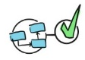


Provider experience improvements
First tranche (progressive) by July 2022
Provider experience improvements
First tranche (progressive) by July 2022
Services that optimise provider contribution to (learning &) work outcomes
Changes to the Provider Experience
System Developments
Integrated tender, licensing & provider management
The whole engagement & licencing process can be managed from one system
Integrated tender management system
New public web portal & single interface for dept staff to assess tenders
I now have one interface & tailored, interactive dashboards, which makes contract & case management clearer & easier
JUL 21
I get regular feedback on my performance & payments through the system
Beta release of improved provider caseload search & faster screen loads in ESS
Expanded display from 9 fields to 40 fields
Multiple sites for display rather than one
Beta release of simplified vacancy management system & diary within ESSWeb
Consolidating screens & reducing input fields & data entry
Streamlined transactions & processes
NESM has significantly reduced red tape in my work, there are fewer screens of data & less manual work
SEP 21
There are guided processes to complete & drive efficient transactions end to end
I save time because I can now search for everything I need in the one place
Release 1 of contract & licence administration CRM (ahead of onboarding)
I can easily see the information I need about a job seeker when I need it
DEC 21
The system tracks required performance obligations & outcomes
Employment Services Transition, including automated offers from system
I can login using my one government ID & can see all the information I need
MAR 22
I can connect my purchasing data with supporting approvals & legal documentation
New payment system supports NESM policy settings
New interface for providers for contract management with guidelines & learning
New interface for caseload management via ESSWeb 2.0
Bulk job seeker transfer functionality: allows transfer from one provider to another
Improved global search functionality
Time to target assistance to disadvantaged job seekers
BY JUL 2022
We now use a system that gives providers a good user experience with refined workflows, allowing us to spend less time in the system & more time helping job seekers
Notes:
For release dates that have already been set, there are details on what system developments will be released.
Some of these development may not be directly visible to providers on the release date as it may be work behind the scenes on a system build. However over time, these developments will become more visible and available to a provider.
We’ve taken the same approach for individuals and businesses and have created a release cycle on a schedule for both.

Slide 11
Part 2: Engagement Approach
Part 2: Engagement Approach

Slide 12




Engagement Approach (current)
Employment Services Advisory Group (monthly)
New Employment Services Trial (NEST) Evaluation Advisory Group (as required)
NEST Provider Bilateral Meetings (bi-monthly)
Provider Engagement Forum (bi-monthly) Peak Stakeholders (monthly) Peak Partners (monthly)
STRATEGIC
Provide advice, guidance
& recommendations on
the strategic direction
STRATEGIC
Guiding our
direction
OPERATIONAL
Program/project working groups established to
co-design solutions & provide expert technical advice
Innovators Forum (3 times per year)
User Centred Design Micro-policy & Platform Research (as required)
OPERATIONAL
Testing Design,
Model &
Framework
Engagement
Approach
(current)
Adelaide South Working Group (every 6-8 weeks)
Mid North Coast Working Group (every 6-8 weeks)
Bilateral meetings – ACCI & BCA with Dept
Employer Mobilisation & Employment Facilitators
TACTICAL
Bring together key stakeholders to share information, collect
feedback
TACTICAL
Solving problems
together
Provider CEO Livestreams (monthly)
CEO letters (as required)
Training & information sessions (webinars, video conferences, Online)
Website & factsheets
Presentations to external forums (as required)
INFORMATIVE
Open Information Forums
to disseminate information
to interested stakeholders
INFORMATIVE
Staying
connected
Notes:
Now we will talk about how we will approach engagement.
On a very broad level, we have categorised our engagement into the following:
strategic engagement
operational engagement
tactical engagement
informative engagement.

Slide 13
Engagement Roadmap
 | THEME | INITIATIVES | 2021 2022 2023 Future
1 | Strategic Engagement
2 | Service Design (e.g. API Services)
3 | Digital Platform
4 | Resilience & Technology
5 | Known Product Roadmap
6 | Future Work
7 | Right Fit For Risk (RFFR)
8 | ?
IN DEVELOPMENT
Notes:
Our engagement roadmap is in development and once finalised, will be made available to all stakeholders.
The goal in the next few of months is to identify the levels of work and how to structure that information.
Using an example for the ATO from when they shifted the way they worked, conversations started with strategic engagement.
Key questions that we should consider for strategic engagement include:
How do we approach engagement?
What does the next 5 to 10 year journey look like?
Where does policy need to shift to enable that journey?
Who are the right people, forums or interest groups that we can get together to constructively build a future world and think across ecosystems?
We should consider the following questions at the Service Design level:
Who are the groups, people or lead providers we work with, so we can start detailed design around services?
What are the high volume APIs that we should be building and how do they work?
What taxonomies do we need to build around the APIs?
What do we need to think about when we are trying to remove red tape from everyone’s systems, our system, the employer’s system and the provider’s system?
At a platform level:
Who are the people we need to be working with to help with discussions on the platform or to test the platform?
We are currently reimagining resilience and technology so that we can agree on what APIs needs to be fully available, which APIs need to be cached and which need to be partially available.
Who are the people that we sit with to work out this layer of engagement?
As we create product roadmaps, we know there is information available from policy, budget or government announcements.
How do we map this roadmap so that everyone is clear when we are going to build, when we are going to deliver and when the APIs are available for use?
Separate to all of this:
What are the innovation options that we can do that are discretionary?
What is the backlog of work that is based on irritants and that we need to start to schedule?
What opportunity exists with other agencies or other ecosystems and how do we scope that out?
Underpinning all of these layers is Right Fit For Risk (RFFR).
How we handle our risk today will not suffice in 3 to 5 years. We need to continue to tighten how we manage our risk over time. How do we make sure we do this and how do we support sectors in aligning with that agenda?
With the ATO example, we undertook this approach by looking at all these engagement layers with a software industry that interacted with ATO ecosystems, the intermediaries, the agents, the accountants associations and the book keeper associations. This enabled the ATO to understand a joint view about the future world and it moved the whole ecosystem into a different level of maturity
To give you a specific example, in 2013, a tax agent would have to enter their details at least five times. In 2020, a tax agent would work in a system and that system would naturally interact with the ATO. The tax agent would not have to enter information directly with the ATO because the systems talk to each other, and not only that the system dynamically interacts with each other in real time.
And as the agent is working in that system, their system in pulling in all the data and ratings in real time and presenting that information on a dashboard. This dashboard was fully customisable and the agent could see the information in whatever lens they needed.
This was a transformational shift in terms of experiences for our intermediaries and similarly for a whole bunch of industry sectors. But that was a journey that took several years and was based on mapping out all the engagement layers.

Slide 14
Part 3: Improving Provider Experience
Part 3: Improving Provider Experience

Slide 15
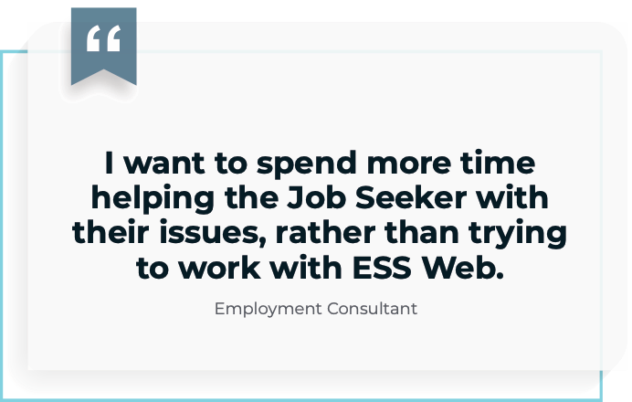
Improving ESS Web for Providers
15
Notes:
We want to understand existing Employment Service Provider behaviours when using Employment Service System Web (ESS Web), including barriers they encounter when inputting data on the platform.
Using exploratory research techniques our goal is to understand the user’s journey both inside & outside of the platform allowing us to uncover design opportunities to meet challenges that are identified.
Research is planned and conducted around current policy, functions, & features in ESS Web.
Research prototypes are based on the existing platform that are enhanced with a new user interface, process improvements and improved technology stack.
There has been consultation around ESS Web and how functional ESS web is today for our providers.

Slide 16
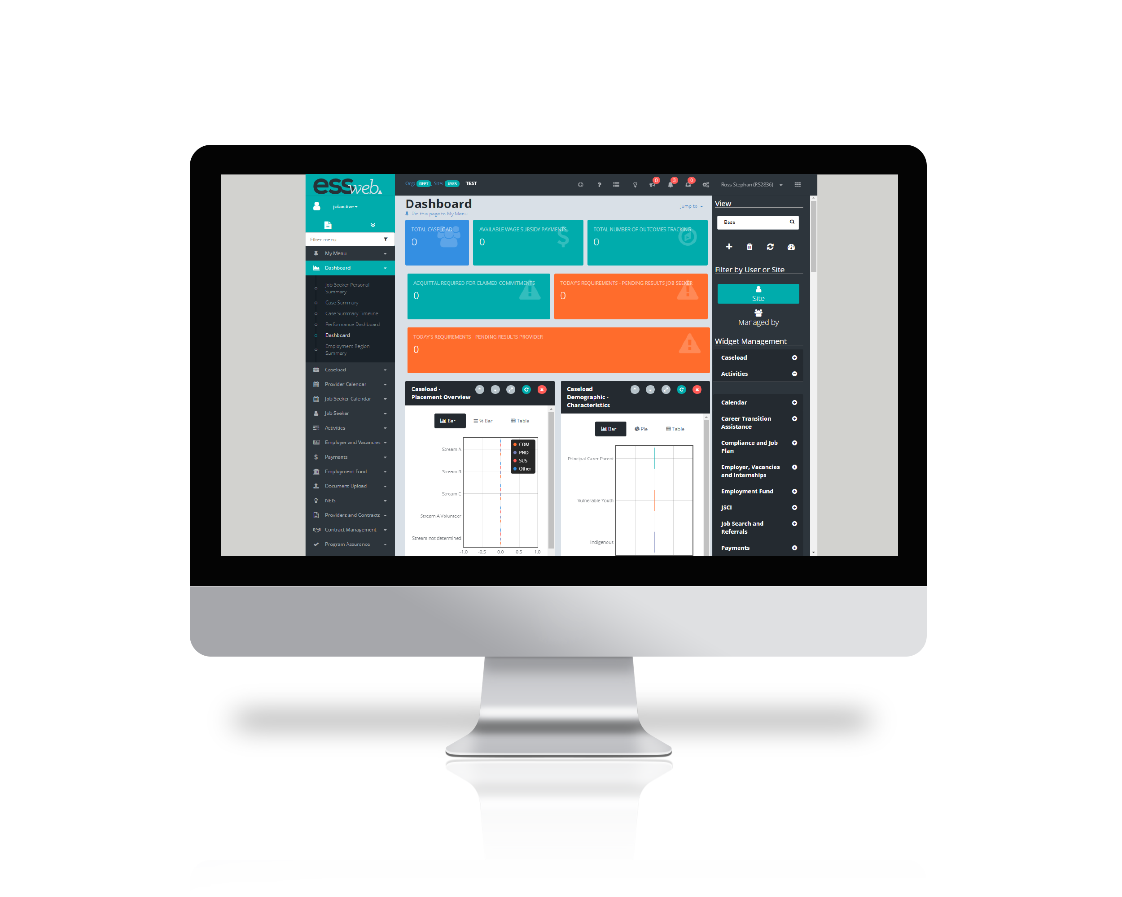
Contemporary Online Services for Providers
From ‘functional silos’ to ‘integrated design’
Eliminates duplication
In production mid-2022
Commencing user testing
Progressive development of betas
16
Notes:
At a very high level, the redesign of the online environment for providers is going to be a foundational platform for how we provide services for all providers longer term, not just employment services providers.
Our engagement regarding platform and systems will be increasing over the next few weeks, particularly with providers, employers & IT system integrators.
We want to ensure our online service for providers ie ESSWeb is more modern and contemporary, the current version is a 2015 platform base but some of the functionality has been carried over from prior periods.
We are moving from functional silos streams towards a more integrated workflow design.
We are trying to eliminate duplication, such as entering information multiple times or repeating transactions on at multiple areas in the system.
The redesign will be in production by mid July 2022.
We have already started a process to engage with those interested in prototyping and user testing. For all of these engagements, it is important for us to have a large, diverse group of people to draw upon to ensure engagement with & participation from a broad range of users.
Beta versions will be progressively developed up to July, as to avoid big bang system release and to be confident we are ready on release.

Slide 17
Challenges
Opportunities
&
The ESS Web application is presented with the following challenges:
We will change the way we build websites to improve performance. This includes:
Updates require build & deployment of the full website.
Modern interface based on an integrated workflow
ESS Web is using legacy UI technologies, not Single Page Applications (SPA) technology.
All SPA technologies address key user pain paints of stability & speed requiring less trips to the server & smaller payloads.
The current design limits the use of local caching, causing multiple round trips to the server to retrieve information.
More use of local browser caching
Business rules are not replicated at the client side forcing multiple trips to the server.
More validation logic done at the client
Use asynchronous calls from the browser to retrieve server data - limiting user interruption.
Vue.js was chosen as the Single Page Applications (SPA).
17
Notes:
We have already started moving towards some of the opportunities to change the way we build websites including:
the modern interface based on integrated workflow
the SPA
introducing local browser caching
validation logic being done on the client side
Other system improvements.

Slide 18
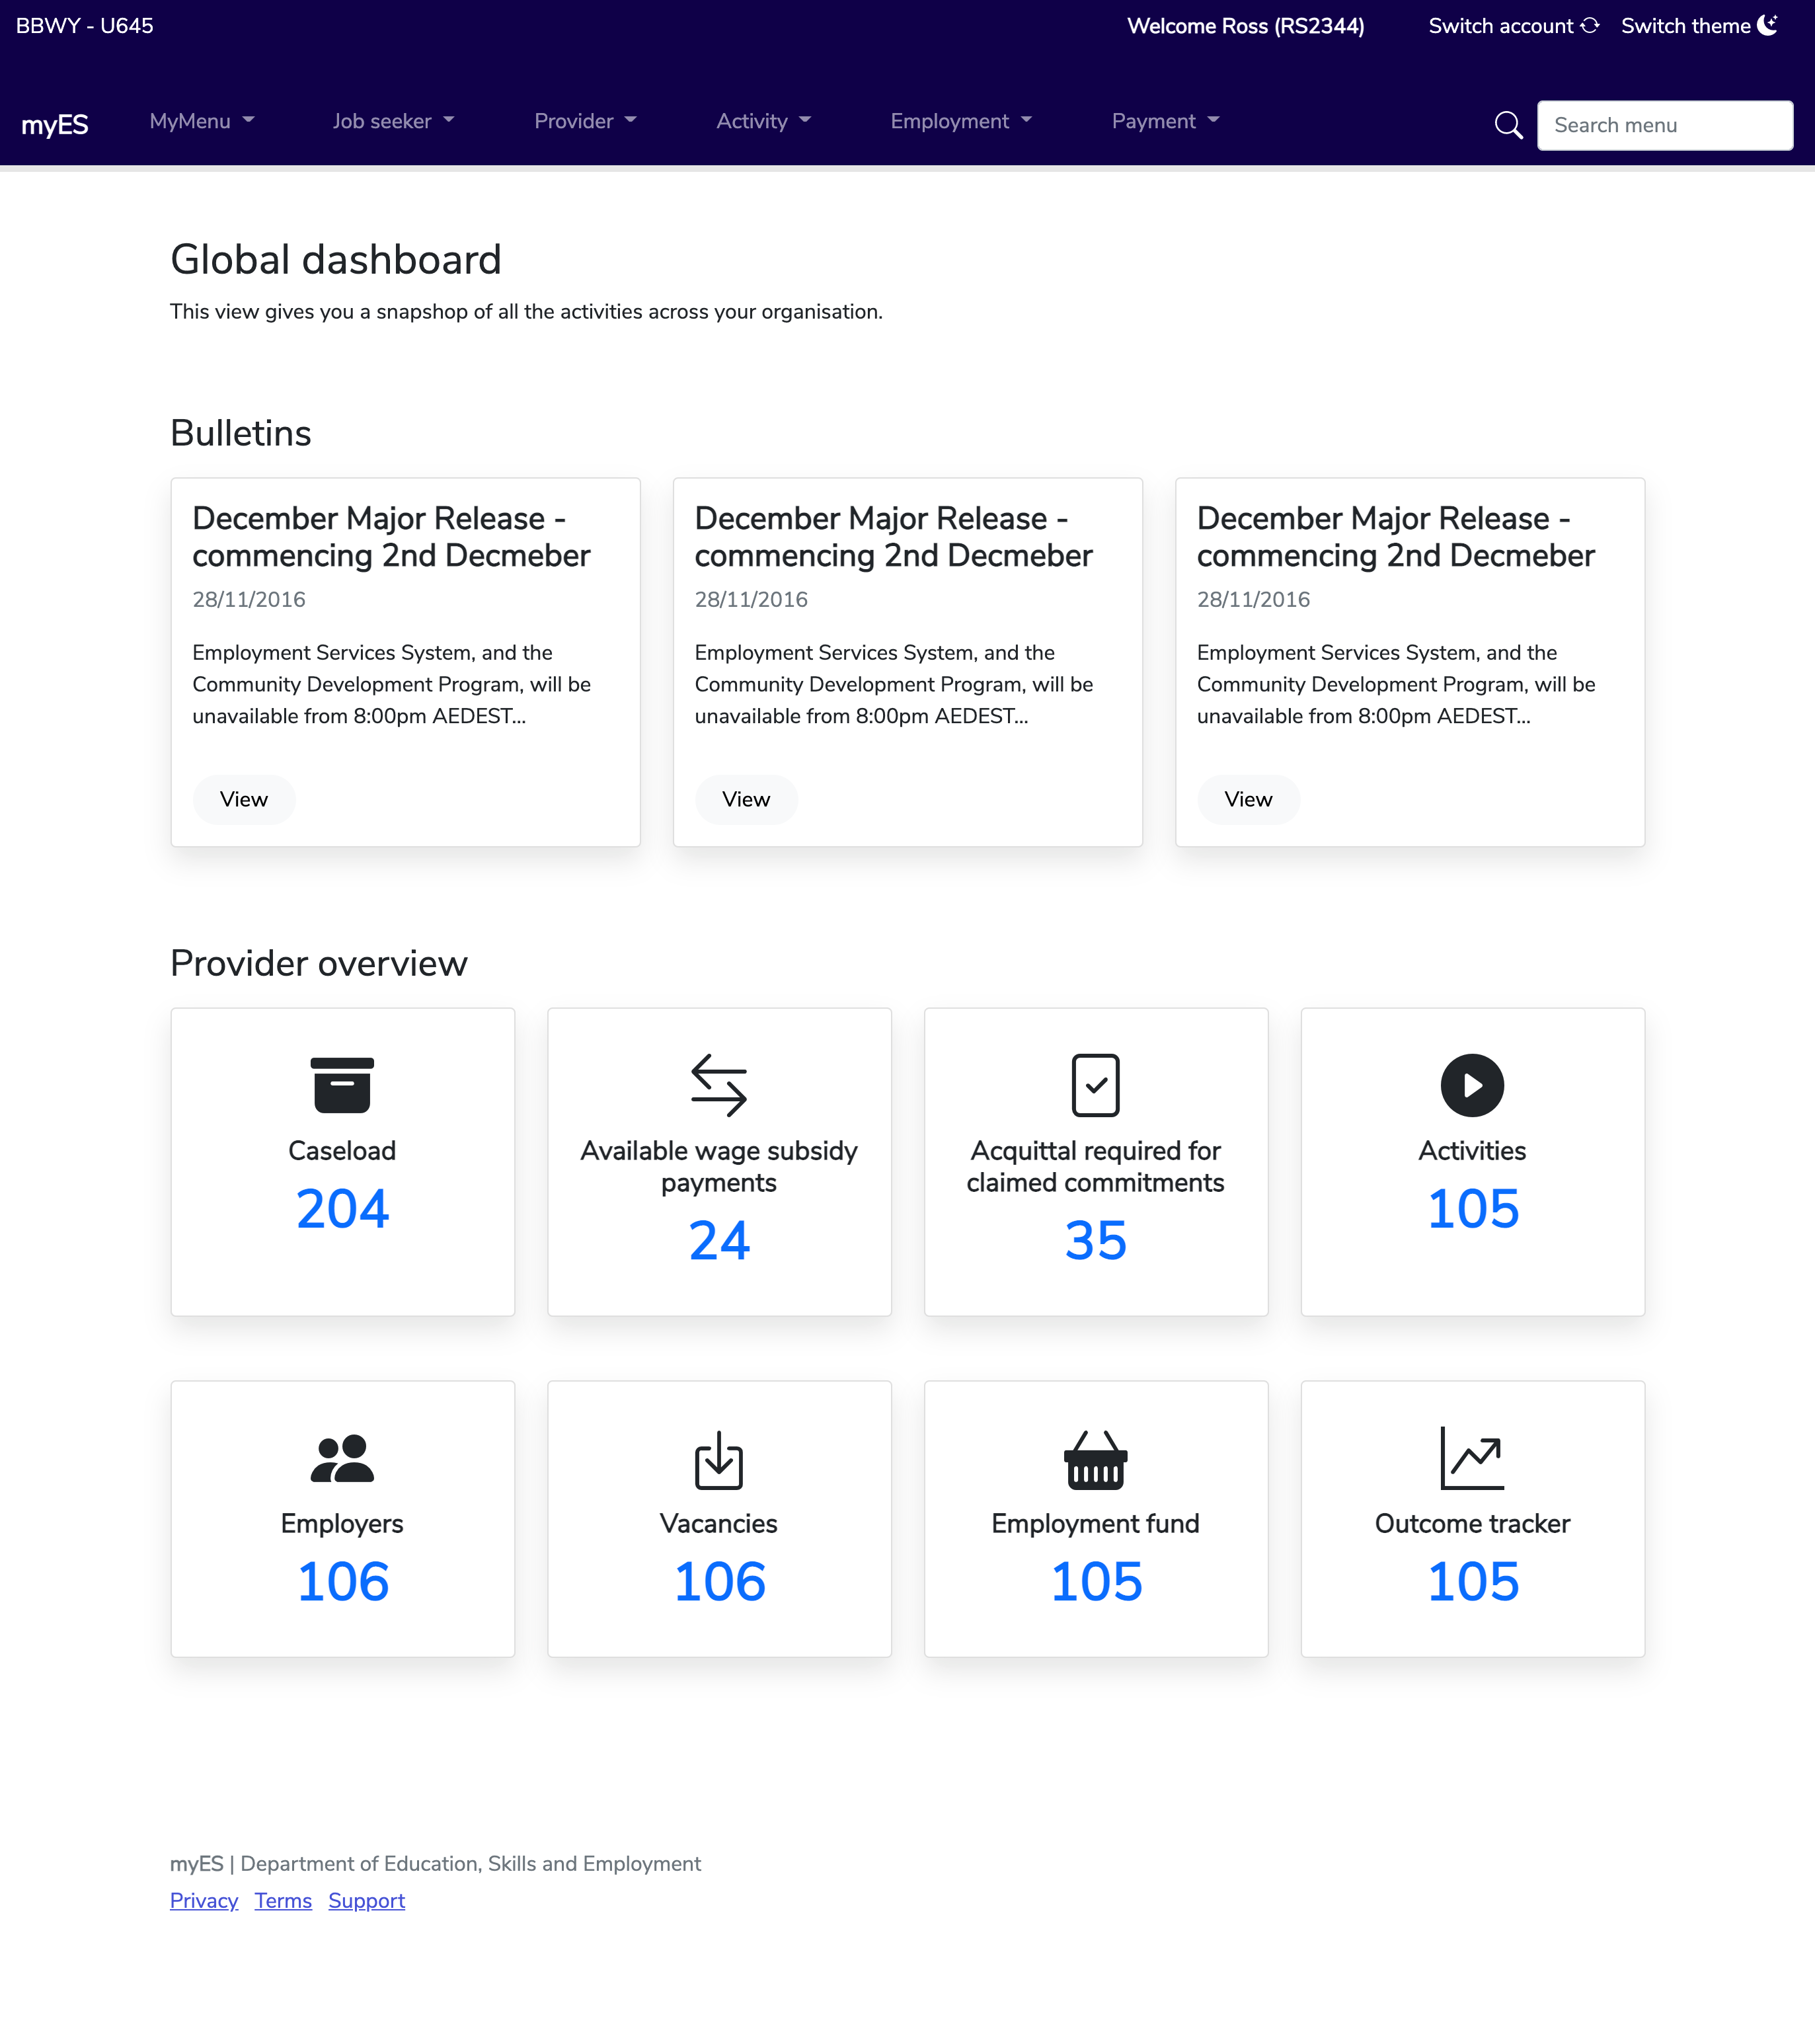
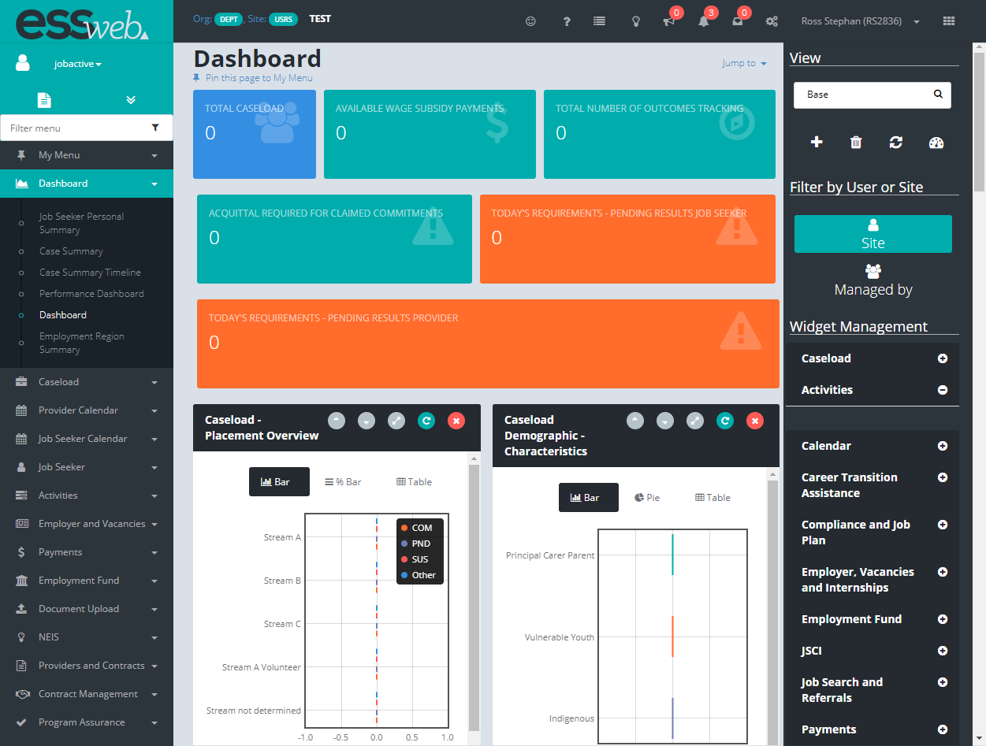

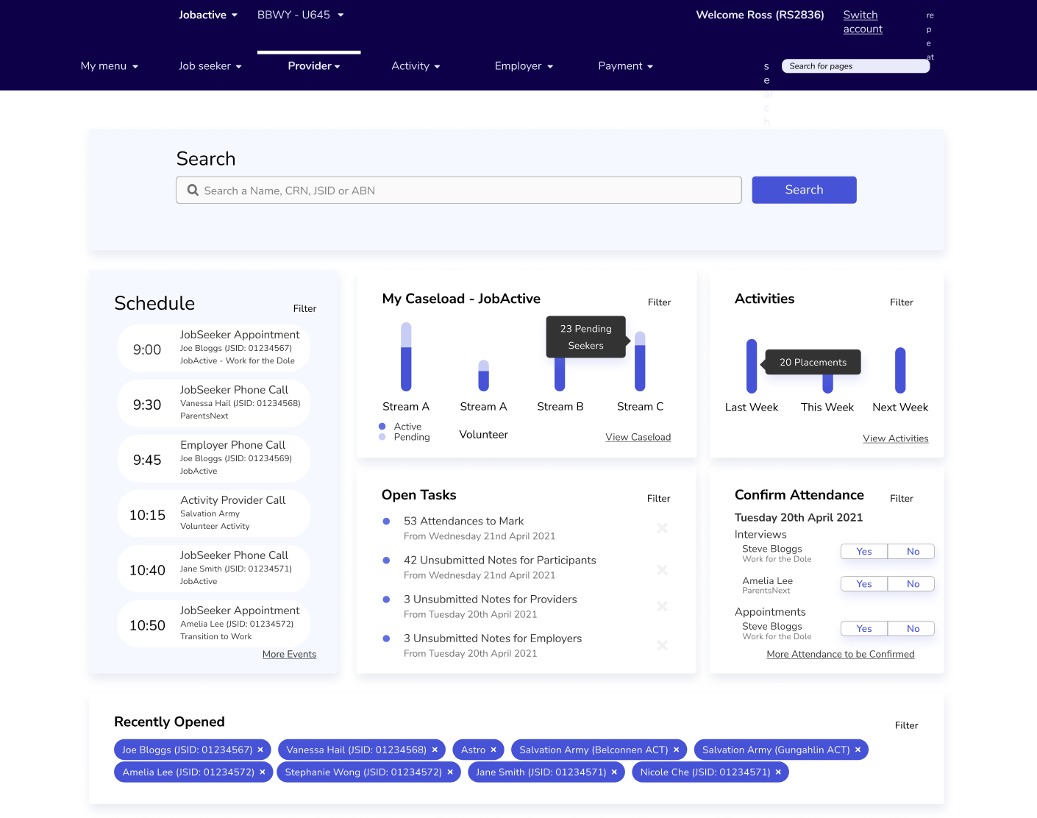

Provider experience Dashboard
Provider experience
Dashboard
To…
Restructure of hierarchy
Clear choices to action
Snap shot of what is important
From…
No hierarchy of information to help users understand important information
Elements that don’t provide a clear understanding
Misaligned importance of information
From…
…
These designs are ‘work in progress’
Untested concept​
Notes:
The way that we are building the system reflects some of those principles we spoke about earlier.
We are actually moving towards more integrated services rather than somebody on relying on what they know to find the screen the find the screen they need under multiple layers.
We have commenced our user research and have begun prototype testing with providers. The purpose is to test changes to the platform to make it easier and user friendly.
We have transitioned to an ‘opt in’ model of research. Building a list of Service Providers willing to participate in research activities over the next 12 months. We envision this list will be rolling and fluid, with Providers opting in and out as their commitment and understanding change. Those who become research participants, will be in a pool of people who may be contacted to take part in research workshops, digital meetings and other research activities over next 12 months. The focus for this engagement will be on the existing ESS experience, & future system design.
As at 15 June, 70 organisations and 319 individuals have opting into our engagement opt in model.
Our digital & business teams are doing a great job to reconceptualise this for users.
We have a broad scope between now & June, based on user testing, prototypes being developed.
Expect to see more over the next couple of months as we work in increments.
Expect to see components of the platform, developed, tested, refined and landed for full production and fairly close to full functionality between now and June next year.

Slide 19
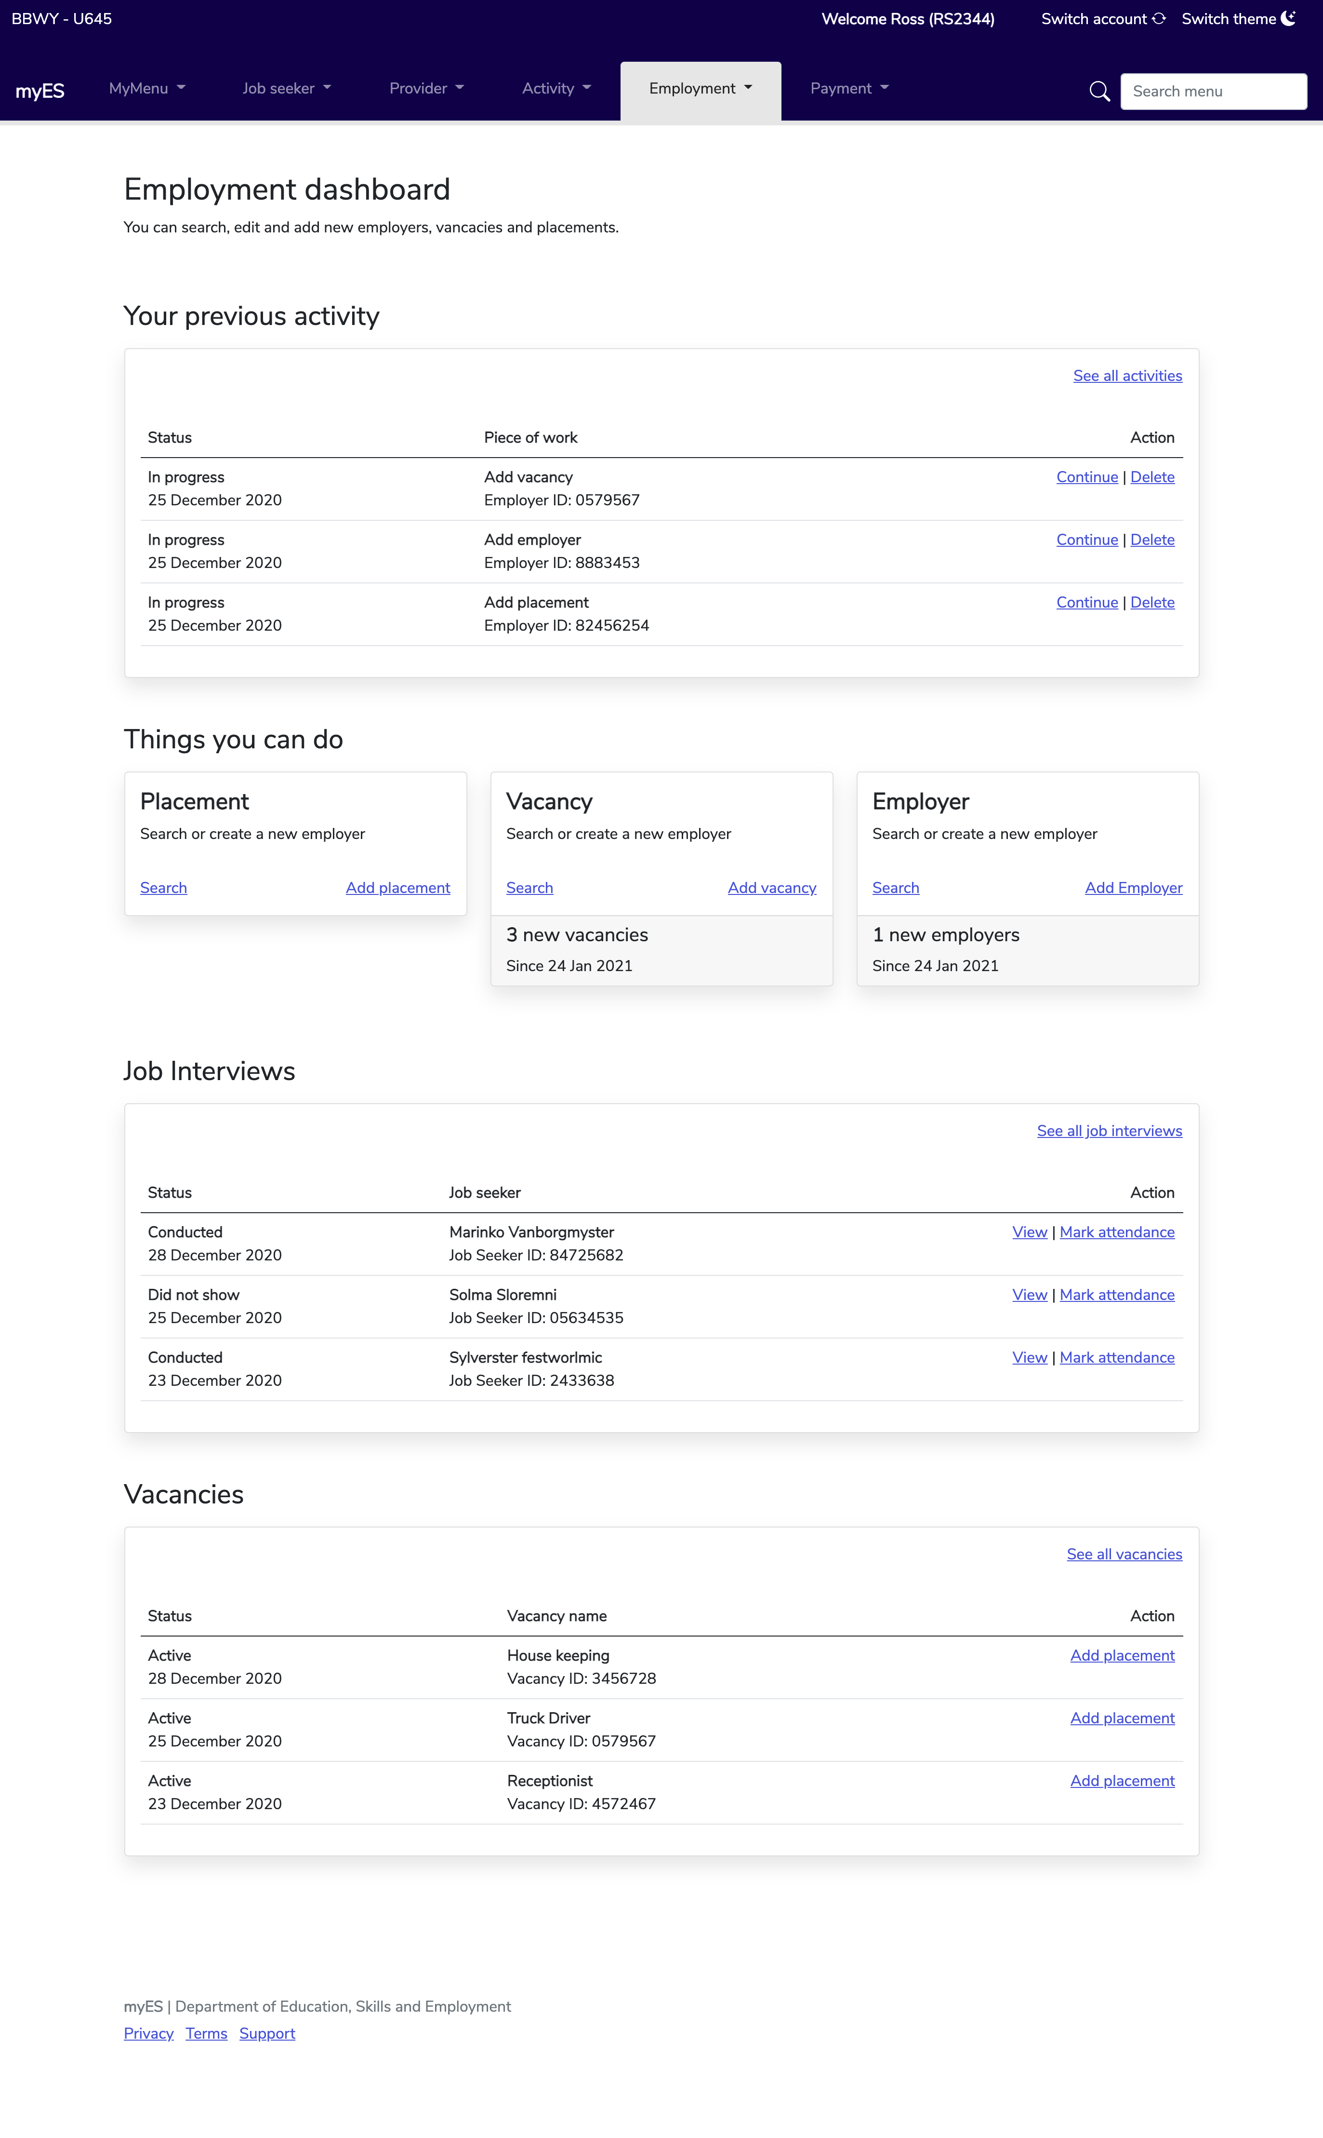
Provider experience Dashboard cont.
Provider experience
Dashboard
To…
Restructure of hierarchy
Actionable items
Clear choices
Prioritise workload
From…
No hierarchy of information to help users understand important information
Elements that don’t provide a clear understanding
Misaligned importance of information
From…
…
These designs are ‘work in progress’
Notes:
As we collect feedback through the user testing of the screens, we will be creating a single repository of feedback and which will be published.
In the lead up to this session, we had asked specific questions to providers as to what they would like to see. 80 per cent of that feedback would be related to the design of ESS.
What we will do is to turn that feedback into line items of work that will be provided to our teams working on the development of ESS.
These teams will categorise these line items and either agree to schedule the item for work, agree and put into a backlog or not action because it is redundant.
We will make sure to have these feedback line items be visible so you can see our position regarding every item we are receiving feedback on.

Slide 20
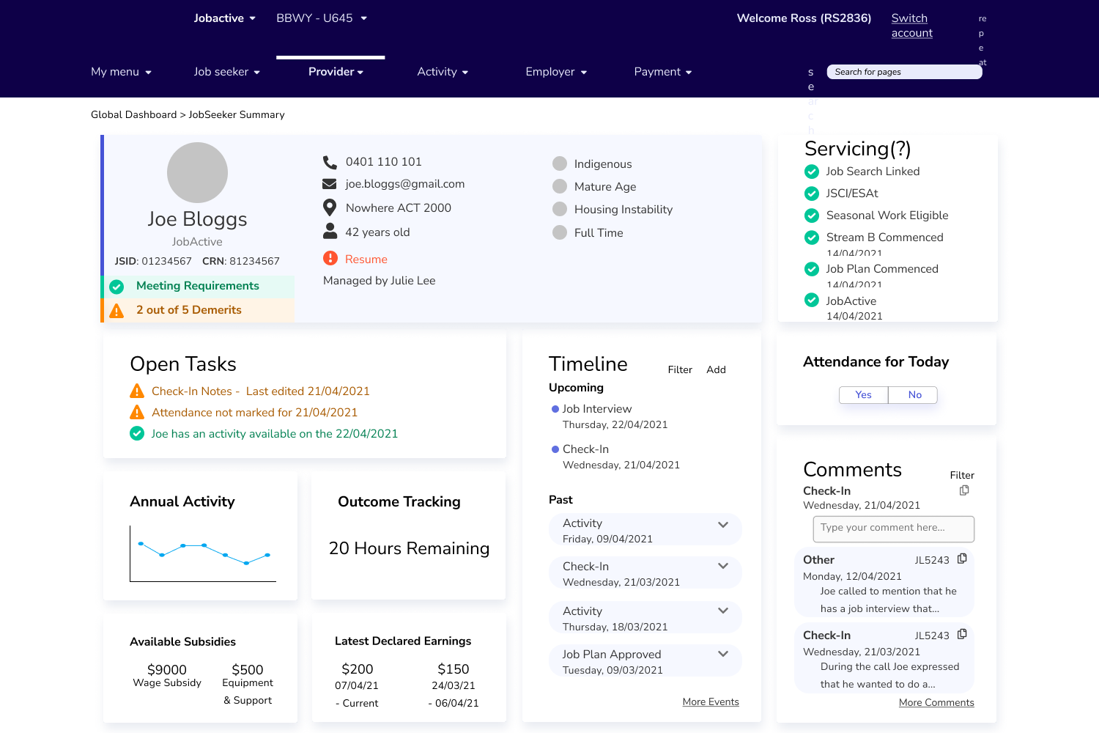
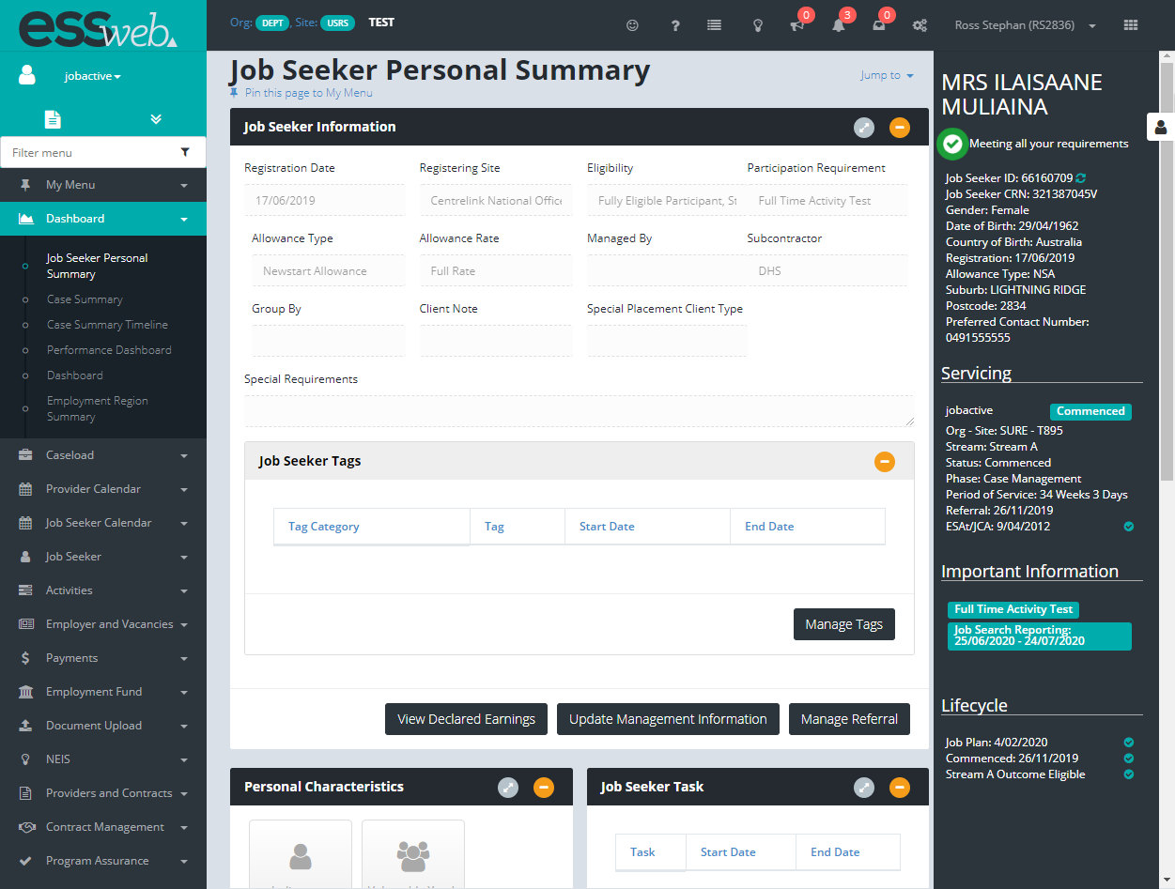
Provider experience Job Seeker Profile
Provider experience
Job Seeker Profile
To…
Information relating to the job seeker & managing the workload
From…
Important information is hard to find
Irrelevant information displayed d
From…
…
Untested concept
These designs are ‘work in progress’
Notes:
These shifts will happen across a number of platforms.
The idea of making information more visible in a dashboard style and more interactive natively will not happen in just the provider online experience, it will happen for the business and individual online experiences as well.

Slide 21
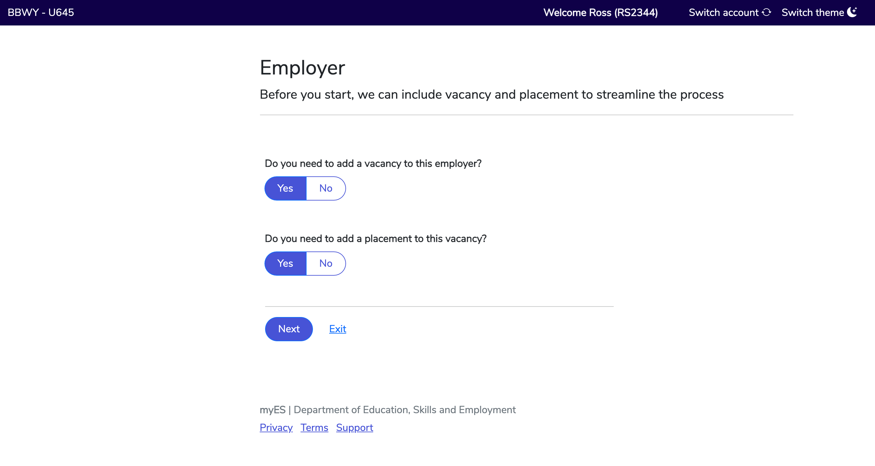
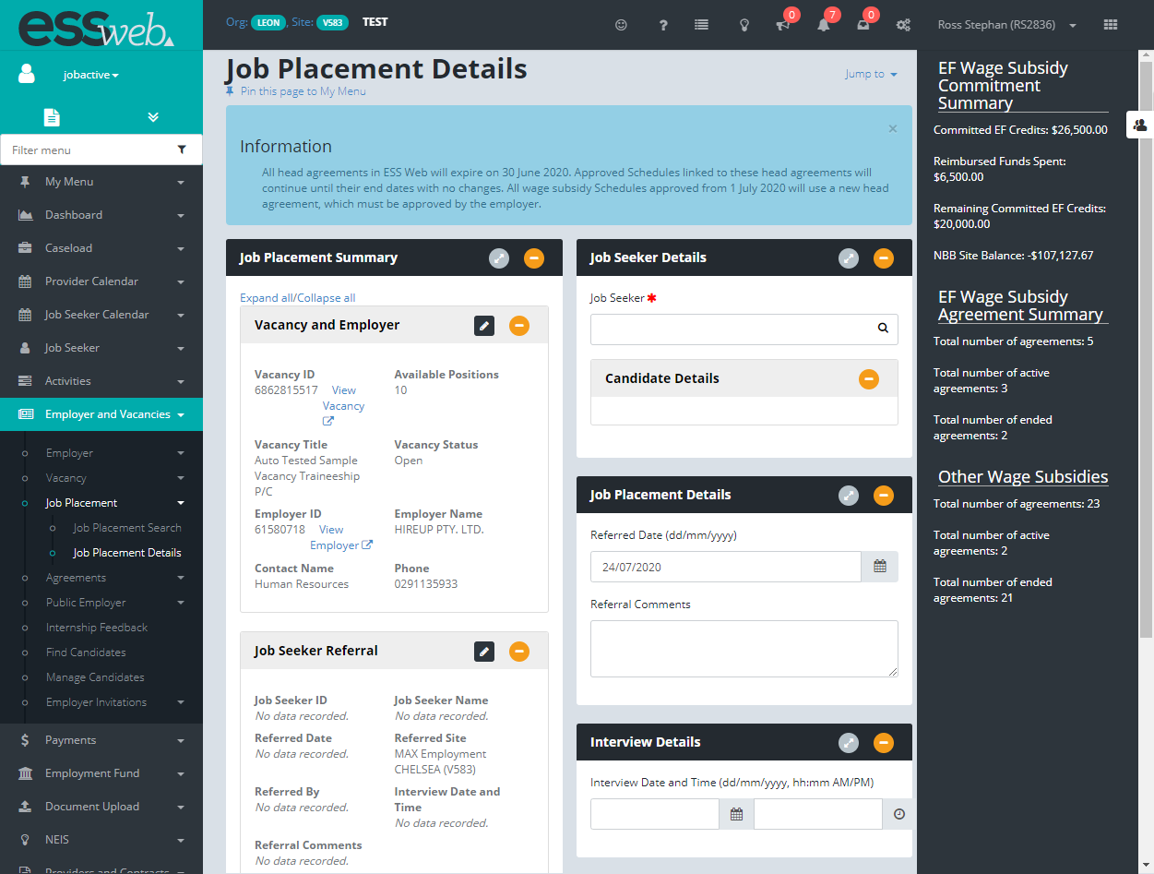
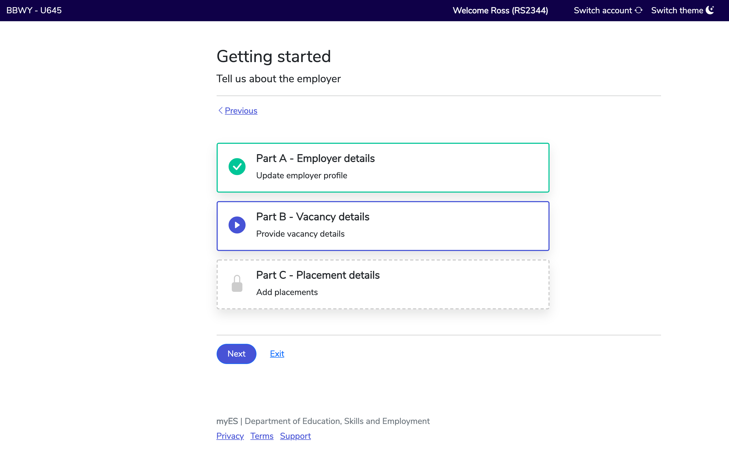
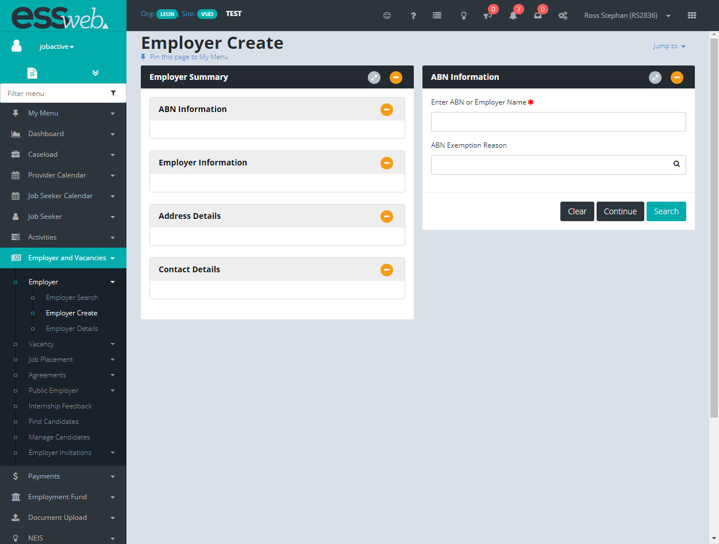
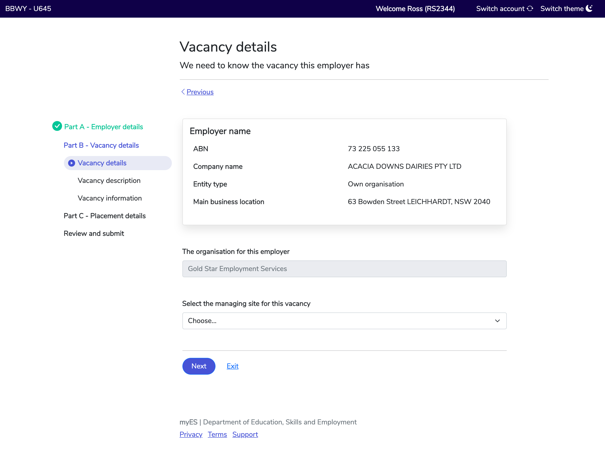
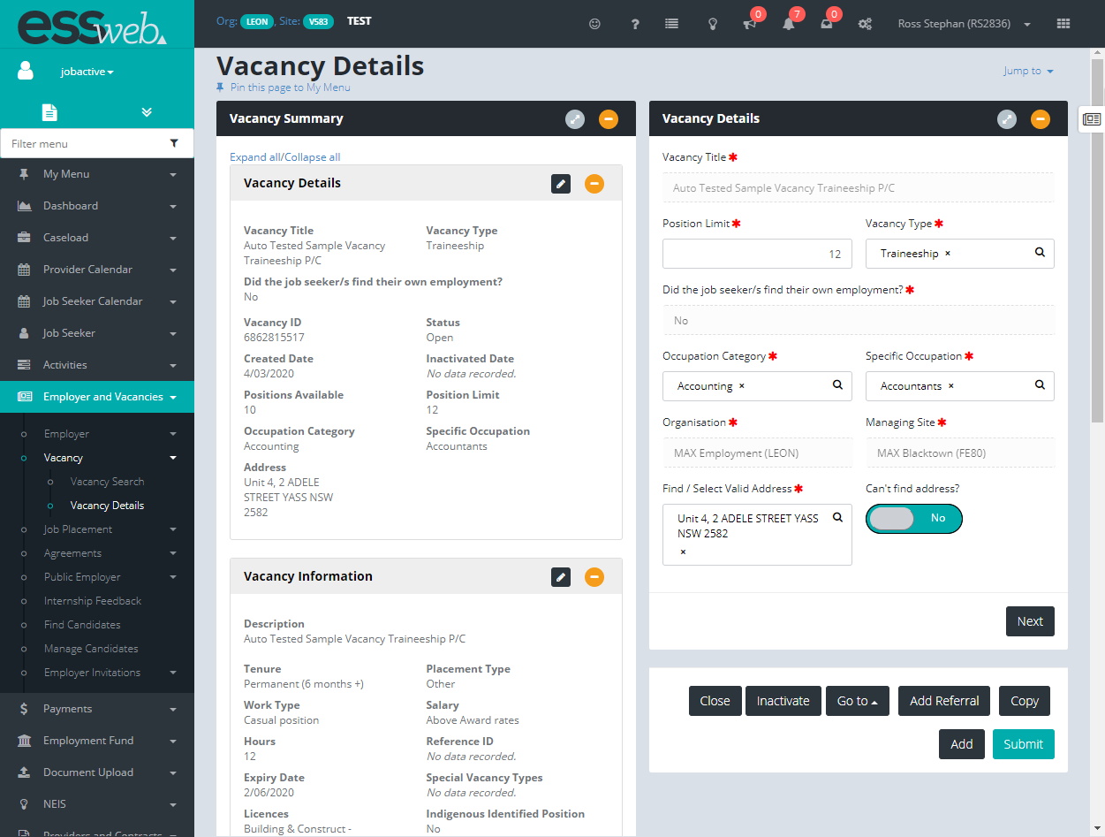
Provider Experience Employer Vacancy
Provider experience
Employer Vacancy
To…
Streamlined flow
Clear entry & exit point
Reduced cognitive load
From…
Separate unlinked flows
Confusing data entry
No clear entry & exit point
From…
…
These designs are ‘work in progress’
Notes:
We will also be looking at what we need to do to help providers improve the way they act on behalf of an employer or business.
We will be testing a whole bunch of screen designs about how providers can create vacancies on behalf of businesses

Slide 22




User research – how to opt in
You can opt using the Bulletin on
ESS Web or the on the Provider Portal.
User research - How to opt in
Alternatively, you can email providerexperience@dese.gov.au
& a team member will forward
you the sign-up link.
Notes:
If you are interested in participating, you can:
opt in using the Bulletin on ESS Web or on the Provider Portal
email providerexperience@dese.gov.au and a team member will forward you the sign-up link
It must be noted we are not going to deliver all of the system features by 30 June 2022, but we certainly want to deliver an exponential increase in capabilities and performance relative to where we are today.
We will have an accepted and agreed backlog that will form future work plans that is beyond 30 June 2022 and have mechanisms to prioritise and produce items in a backlog.

Slide 23
Part 4: accreditation & security
Part 4: Accreditation & Security

Slide 24





Accreditation & Security
Collective responsibility to be compliant & minimise reputational & security risks of system
Increased functions = increased risk
Currently, not all have met requirements
All requirements must be met
Over time, we need to explore further hardening
24
Notes:
The next area that we are going to focus on is accreditation and security.
Providers today have access to a level of information for individuals that may not even be their current client base that is beyond anything that the average consumer would understand.
It is absolutely critical that we continue to increase the security around the level of information access because we all know that trust in the system will quickly erode based on the lowest common denominator.
The weakest link in the chain that is breached will compromise trust and will put pressure on us to reduce access or reduce the opportunities for future APIs.
We have to make sure that current accreditation is fulfilled and we also have to harden security over time for future services to providers or future online access to providers.
This is not negotiable. For those providers who have not met accreditation requirements, we will be reaching out to them to say we are at risk and they must demonstrate to us in how they will conform in a timely way.
This may sound harsh but having an environment where lots of records are downloaded and then posted into a dark web, puts our reputation at stake.
We must ensure that any information we share in an ecosystem that is secure and protected.
Over time, we need to work out what this means now and into the new next few years.

Slide 25

Security & Accreditation must continue to mature
Security & Accreditation must continue to mature
    Right Fit for Risk
Current RFFR will be enforced
RFFR will be further hardened over time
    Digital ID (myGovID)
July 2021: all businesses
Date TBC: all providers
& their staff
Future
Hardening
of Security & Accreditation
    Support
    DESE building a significant support function
    Large investment in
    future co-design
    Monitoring
    Enhancement of audit logging, monitoring & data matching to detect & prevent risks
Notes:
I’m keen to make sure we get this right as we are going to be pushing for more access to information in other government agencies.
We want to make the information available to our partners, whether it be providers or other agencies, so we can offer more holistic and more tailored service.
That journey will be highly dependent on the trust of our ecosystem. If we don’t increase security in our ecosystem, we won’t be able to provide that information proactively.
For employers, we are hardening the logon they use. We are doing some work to adopt the mygovID credential used by other agencies. This will be the logon they must use as an employer, and will likely be turned on in June this year.
We are moving away from DESE to a whole of government credential.
Most employers will be able to reuse this, some employers will need to get it, but the intent is to move to this in June and then decommissioning our systems for the more secure logon in September.
That is already in production in over 76 other online environments for businesses for over 30 other government agencies and 2 million businesses are already using that credential, so that is a production level environment that is being used broadly, we are just onboarding.
For providers, we need to do something similar in the coming 12 months.
We will be having discussions with providers about moving people to mygovID for access, timing, what we can do and the change management process.
As an example, a person has set up their myGovID at a level 2 maximum which is scanning their documents and creating a token on their device. Once that personal identity is setup, that identity is portable.
The provider has to manage the authority system that the person works for and that person has permission to see information on behalf of the provider.
There is an onboarding and offboarding required for that persona and must be managed.
We are moving the authority management away from a token, user name and password, to the authority of a personal token.
The person does not lose their personal digital identity when they move providers.
These discussions will commence soon, but in essence we are looking to harden login for providers, their staff and their direct services.

Slide 26
Part 5: Future Opportunities
Part 5: Future Opportunities

Slide 27

What you said (key themes)
Current ESS Web needs to be more functional
e.g. improved layout & workflow
More data & interactions (e.g. income, Services Australia interactions touch points, STP data)
What you said
(key themes)
More digitally connected systems
Improved API interactivity
Notes:
Four key themes have emerged from feedback on what the interest for the future would be:
1. Current ESS Web needs to be more functional
80 per cent of feedback was on ESS web and improving that online interface and I absolutely agree for what needs doing.
We need to start to build use cases to check whether the law allows it, and if it doesn’t, we need to build a good business case for it and start to think about what that means in terms of getting a policy shift. We will need your help to imagine that world.
2. More data & interactions
We received feedback on prioritising machine to machine interactions so that we can provide direct access to systems either from provider software or third party software.
3. More digitally connected systems
We received feedback on moving towards more digitally connected systems rather than people typing stuff in.
4. And finally, improved API interactivity.
The feedback we’ve been receiving has been consistent with the story we’ve been telling to date.

