Slide 1
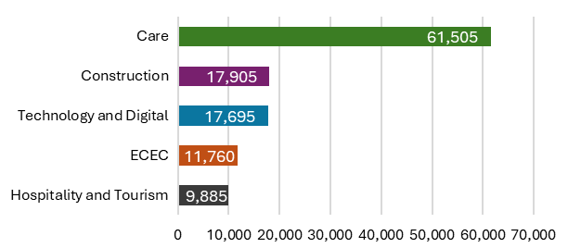
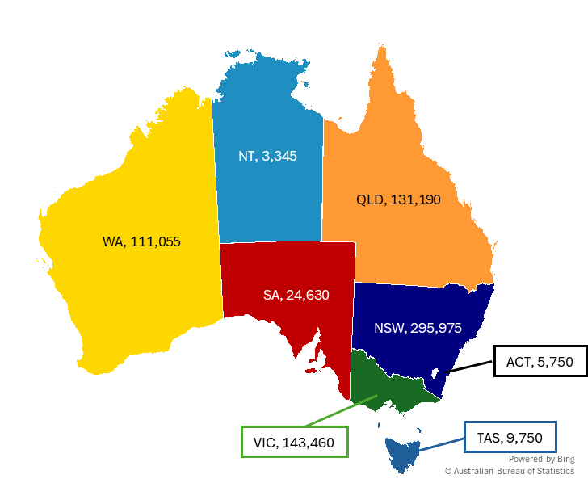
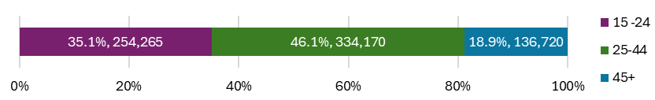
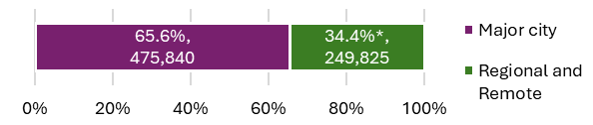
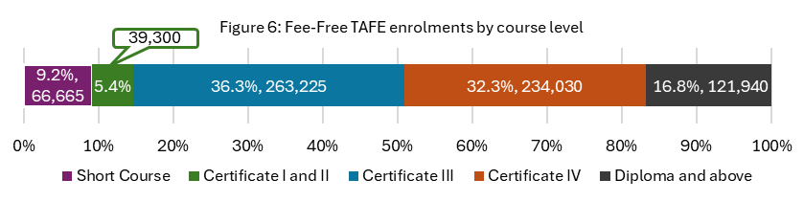
Fee-Free TAFE program (1 January 2023 to 30 September 2025)
Through the Fee-Free TAFE Skills Agreement, the Australian Government has partnered with states and territories to deliver over $1.5 billion in funding for more than 500,000 Fee-Free TAFE and vocational education and training (VET) places across Australia from 2023 to 2026. This snapshot sets out quarterly reporting data over the period 1 January 2023 to 30 September 2025.
Fee-Free TAFE continues to have strong enrolments in all states and territories.
There have been more than 725,000 enrolments from
1 January 2023 to 30 September 2025.
Fee-Free TAFE supports training places in priority sectors and helps priority cohorts access training
Figure 3: National priority sectors with the most Fee-Free TAFE enrolments
As of 30 September 2025, there have been 213,900 completions since Fee-Free TAFE launched in 2023
Figure 8: National priority sectors with the most Fee-Free TAFE completions
Sector | NSW | VIC | QLD | WA | SA | TAS | NT | ACT | Total
Care | 76,200 | 40,000 | 29,145 | 41,590 | 6,475 | 3,515 | 555 | 1,185 | 198,665
Technology and Digital | 24,840 | 11,125 | 13,970 | 13,170 | 4,380 | 555 | 115 | 1,095 | 69,245
Construction | 17,700 | 21,430 | 9,620 | 4,850 | 3,670 | 940 | 285 | 530 | 59,025
Early Childhood Education and Care (ECEC) | 20,530 | 6,915 | 8,235 | 18,110 | 1,300 | 580 | 300 | 500 | 56,465
Hospitality and Tourism | 12,275 | 3,805 | 2,360 | 5,870 | 1,580 | 880 | 340 | 380 | 27,495
Figure 1: Fee-Free TAFE enrolments by jurisdiction
Figure 4: Fee-Free TAFE enrolments by priority cohorts
 | NSW | VIC | QLD | WA | SA | TAS | NT | ACT | Total
First Nations Australians | 24,750 | 1,800 | 9,020 | 5,470 | 420 | 830 | 1,505 | 270 | 44,070
People with disability | 16,765 | 15,595 | 13,610 | 11,035 | 985 | 1,755 | 310 | 1,470 | 61,520
Job seekers | 109,435 | 30,555 | 24,350 | 5,185 | 5,825 | 2,775 | 580 | N/A | 178,705
Young persons (24 and under) | 86,785 | 60,060 | 57,675 | 37,430 | 6,585 | 2,920 | 785 | 2,025 | 254,265
Women | 193,715 | 80,270 | 75,140 | 74,900 | 13,735 | 5,585 | 2,025 | 3,210 | 448,585
The top completed courses in Fee-Free TAFE are:
Top completed courses
Certificate III in Individual Support
Certificate IV in Training and Assessment
Certificate III in Early Childhood Education and Care
Diploma of Nursing
Certificate IV in School Based Education Support
Fee-Free TAFE helps people in all stages of their working life
Figure 5: Fee-Free TAFE enrolments by age group
And the top completed courses in national priority sectors include:
Care | Hospitality and Tourism
Certificate III in Individual Support | Certificate III in Commercial Cookery
Diploma of Nursing | Certificate III in Hospitality
Diploma of Community Services | Certificate II in Cookery
Figure 2: Fee-Free TAFE enrolments by remoteness ^
Fee-Free TAFE concentrates on qualified training and meaningful pathways to employment
Construction | Technology and Digital
Certificate II in Electrotechnology (Career Start) | Certificate III in Information Technology
Certificate II in Electrotechnology (Pre-Vocational) | Certificate IV in Cyber Security
Certificate IV in Building and Construction | Certificate III in Electrotechnology Electrician
^: The sum does not match the total in Figure 1 due to multiple delivery locations.
*: Includes 0.2% unknown.
Source: State and territory Fee-Free TAFE data reported under Part 3 of the Fee-Free TAFE Skills Agreement.
Notes:
Comparisons should not be made between states and territories’ data due to their varied implementation approaches.
Figures have been rounded to the nearest 5.
The listed total may not match the sum of all elements due to rounding.
The top enrolled courses are focussed on key areas of national priority
Early Childhood Education and Care
Certificate III in Early Childhood Education and Care
Diploma of Early Childhood Education and Care
Introduction to Early Childhood Education and Care Skill Set
Figure 7: Courses with the most Fee-Free TAFE enrolments
Top enrolled courses
Certificate III in Individual Support
Certificate III in Early Childhood Education and Care
Diploma of Nursing
Certificate IV in Training and Assessment
Certificate III in Information Technology
Note: Completions data is as reported in Quarter 3, 2025. Numbers are expected to rise as more students finish their courses, especially those studying part-time or in longer courses.

